Slide 1
COVID REHABILITATION

Slide 2

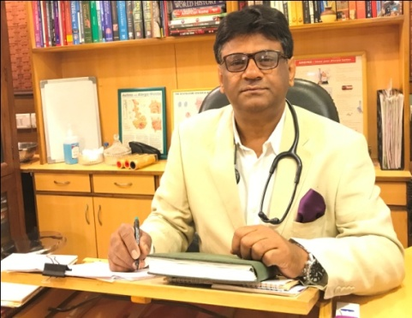


“,
DR P P BOSE
MBBS, MD, DTCD,DNB, FISDA, FBPI
Pulmonary, Critical Care , Sleep Medicine & Rehabilitation
Fellow, Indian Sleep Disorders Association
Fellow, Buteko Professional International
Founder SAANS foundation
Chairman, SAKSHAM Paramedic
“ A Capacity Building in Health Care Sector”
Senior Consultant, National Heart Institute, New Delhi & Fortis
Medical Director, Lords International Hospital, New Delhi
Other affiliations:
Founder Vice President, Indian Sleep Disorders Association
Visiting consultant, Pulmonologist, Max Super Speciality Hospital
Member , Ethics Committee, Tata Energy & Research Institute, New Delhi
Key opinion leader, Astra, Cipla & Sun pharmaceuticals

Slide 3
WHY REHABILITATION IN COVID
Optimizing health and functioning outcomes
Reduce complications associated with admission to an ICU, such as post intensive care syndrome (PICS)
Optimize a patient’s recovery and reduce the experience of disability.
Rehabilitation interventions can help address many consequences of severe COVID-19, including physical, cognitive, and swallow impairments, and provide psychosocial support.
Older patients, and those with pre-existing health conditions, may be more vulnerable to the effects of severe illness, and rehabilitation can be particularly beneficial for maintaining their prior levels of independence.
Facilitating early discharge: Where there is high demand for hospital beds, patients may need to be discharged more rapidly than ordinarily. Rehabilitation is particularly important in preparing patients for discharge, coordinating complex discharges, and in ensuring continuity of care.
Reducing the risk of readmission: Rehabilitation helps to ensure patients do not deteriorate following discharge and require readmission, which is critical in the context of hospital bed shortages.

Slide 4
ROLE OF REHABILTATION IN COVID
Severe cases of COVID-19 are associated with rehabilitation needs related to the consequences of ventilatory support, and prolonged immobilization and bed rest. These may include:
Impaired lung function;
Physical deconditioning and muscle weakness;
Delirium and other cognitive impairments;
Impaired swallow and communication; and
Mental health disorders and psychosocial support needs.

Slide 5
REHABILITATION INTERVENSION (ACUTE)
 | Rehabilitation interventions | Typical delivery setting
 | While patients with severe COVID-19 are receiving ventilatory support, rehabilitation professionals may be involved in supporting acute respiratory management, and the maintenance and improvement of functioning to facilitate early recovery. Specialized rehabilitation professionals can provide interventions that assist in improving oxygenation, airway secretion clearance, and ventilation weaning and can also play a role in promoting nutrition and preventing aspiration pneumonia, especially post-intubation and/or in patients with a tracheostomy. | Intensive and/ or critical care units, high dependency units (including in SARI centres)
ACUTE

Slide 6
REHABILITATION INTERVENSION (SUB-ACUTE)
 | Rehabilitation interventions | Typical delivery setting
 | In the early recovery period, once patients have returned to a hospital ward or stepdown facility, or for patients where illness severity did not warrant admission to an intensive care unit and who have been managed in a hospital ward, rehabilitation interventions may focus on addressing ongoing impairments in mobility, respiratory function, cognition, swallow and nutrition, and communication. Interventions during this period further aim to promote independence with activities of daily living, and to provide psychosocial support. Rehabilitation professionals also contribute significantly to discharge preparation and planning, which can be particularly complex for older patients and those with comorbidities. | Hospital wards, stepdown facilities (including in SARI centres)
SUB-ACUTE

Slide 7
REHABILITATION INTERVENSION (LONG TERM)
 | Rehabilitation interventions | Typical delivery setting
 | Following discharge, rehabilitation professionals can provide graded exercise, education on energy conservation and behaviour modification, home modification, and assistive products, as well as rehabilitation for any specific individual impairments. During the long-term recovery of severe COVID-19, patients may benefit from pulmonary rehabilitative interventions, which target physical and respiratory impairments, and include a combination of graded exercise, education, activity of daily living, and psychosocial support. In many contexts, pandemic related constraints (physical distancing, limited human resources and limited public transport) and infection risks mean that telehealth is likely to be required following discharge. This could be extended to include remote exercise (e.g. “virtual group” education and exercise) and peer-to-peer support from COVID-19 patients who have received the appropriate training. Rehabilitation services located in people’s communities are often best placed to deliver longer-term care. | Rehabilitation centres, outpatient programmes, in-home services, mobile services, telehealth
LONG TERM

Slide 8

What is Disease Spiral of disability?
Increasing Breathlessness
Reduced activity
Chronic Diseases
Depression
Social Isolation
Deconditioning
Drugs
Hypoxia
Peripheral Muscle dysfunction
Disability
Chronic Inflammation
Poor Nutrition
The relationship between chronic lung disease, muscle deconditioning and disability
Reardona J, Casaburi R, Morganc M. Respiratory Medicine 2005; 99:S19–S27.
Notes:
Reduced physical activity occurs as a result of chronic breathlessness and fatigue. The subsequent deconditioning is aggravated by systemic effects
such as peripheral muscle, cardiac, nutritional and psycho-social dysfunction. Suboptimal self-management strategies add to the burden of the disease.
Not surprisingly, peripheral muscle dysfunction is a major cause of reduced function and participation in patients with chronic obstructive pulmonary disease
(COPD), hence physical training is crucial in order to increase exercise capacity, functional status and associated quality of life (QoL).

Slide 9
What are Mechanisms for these morbidities?
Deconditioning
Malnutrition
Effects of hypoxemia
Low Cardiac output
Steroid myopathy
Hyperinflation
Diaphragmatic fatigue
Psychosocial dysfunction from anxiety, guilt, dependency and sleep disturbances.

Slide 10
What is Rehabilitation?
Rehabilitation is a comprehensive intervention for patients with chronic diseases/disorders who are symptomatic and often have decreased daily activities. It is designed to reduce symptoms, optimize functional status, increase participation, and reduce health care costs through stabilizing or reversing systemic manifestations of the disease

Slide 11
Our Objectives
  Prevent & treat medical problems
  Maximize functional independence
  Resumption of pts pre-existing lifestyle
  Reintegrate patient into home & community
  Enhance quality of life
  Facilitate psychosocial adaptation

Slide 12
What are the Benefits?
Improved Exercise Capacity
Reduced perceived intensity of dyspnea
Improve health-related QOL
Reduced hospitalization
Reduced anxiety and depression
Improved limb function
Benefits extend well beyond immediate period of training.
Notes:
Several impairments such as weakness, dysfunction of skeletal and respiratory muscles, anxiety and depression and abnormalities in nutrition have responded to treatment. Improvement in overall and exertional dyspnea and QOL have been demonstrated. Significant increases in maximum exercise capacity have been observed.. Trials have indicated a decrease in health resource use. No trials have documented a survival benefit.

Slide 13
Who can benefit?
Chronic respiratory disease symptomatic with optimum drug therapy
Chronic cardiovascular diseases with breathlessness despite optimum intervention and drug therapy

Slide 14
Components of a Rehabilitation Program
Education
Exercise Training
Psychosocial/behavioral intervention
Nutrition assessment
Breathing techniques
Tailor made therapies
Medications, devices & specific supports
Outcome Assessment
Notes:
These interventions are provided by a multidisciplinary team that often includes physicians, nurses, respiratory therapists, physical therapists, occupational therapists , dieticians and social workers.

Slide 15
Key Components

Slide 16

Our belief

Slide 17
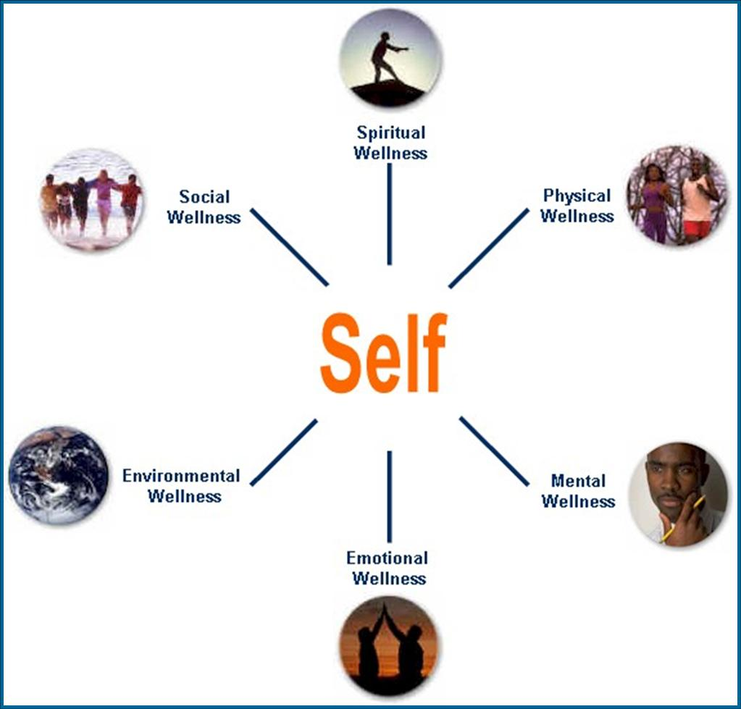
We Preach
360 degree Wellness

Slide 18
Our Methods: ASK
    ATTITUDE
    SKILL
    KNOWLEDGE

Slide 19
Medical History and Physical Examination
Respiratory History
Medical history e.g. NMD/ Orthopedic
Active medical problems
Co-morbidities : Osteoporosis / CAD
Use of medical resources
Surgical/Medication history
Smoking / environmental / Recreational history
Alcohol / drug abuse
History of infections
Vaccination
Physical Examination
  Vital Signs
  Finger clubbing
  Simple walk into office
  Extremities : upper & lower
Breathing pattern
Accessory muscle use
Pulse oximetry
Chest examination
Cardiac examination
NMD – Neuromuscular disease
CAD – Coronary artery disease
Notes:
Complete medical history and physical examination which includes respiratory histories, medical histories e.g. NMD, orthopedic history also current medical problems, co-morbidities, use of medical resources and surgical and medication history to be accurately elicited and noted. Routine physical examination with focus on respiratory assessment is important. Observation of Simple walk in office, pulse oxymetry, breathing pattern are essential to determine eligibility for PR.

Slide 20
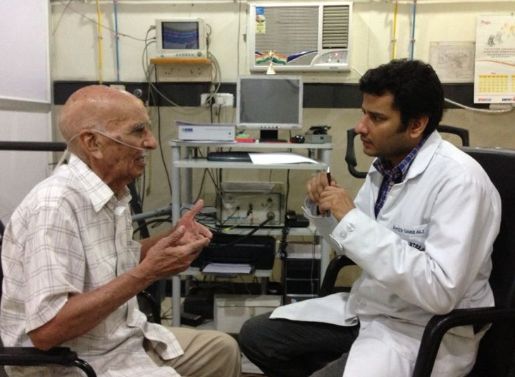
Psychosocial Assessment
Perception of QOL & ability to adjust to disease
Anxiety & depression
Neuropsychological impairment
Motivation for PR by team & pulmonologist

Slide 21
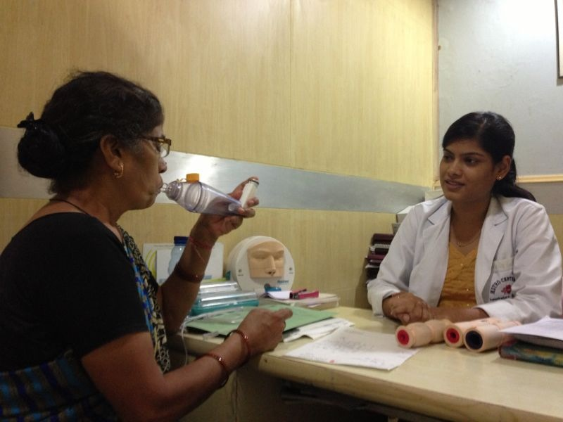
Education assessment
Knowledge about disease & management
Hearing, vision & cognitive ability
Language
Literacy Level

Slide 22
Rehab approach
Yes
Indication
No
Advise
Healthy life style
Assessment
Intervention
Exercise limitation
Skeletal muscle force
Respiratory muscle force
Format exercise training Define intensity
Exacerbations ?
Self management ?
Need for enhancing
Self management strategies
Nutritional status
Need for nutritional interventions
Psychological morbidity
Need for Psychological counseling
Need for daily life adaptation
Occupational therapy
Social support
Provide Social support
Co-morbidity
Include other disciplines

Slide 23

Motivation

Slide 24
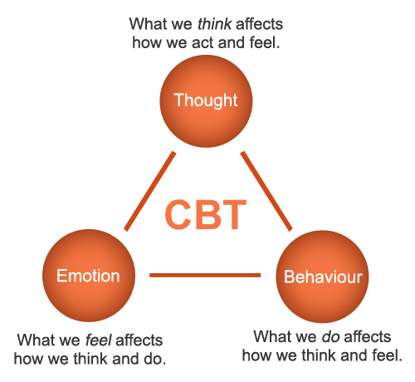
Cognitive Behavioral therapy(CBT)

Slide 25
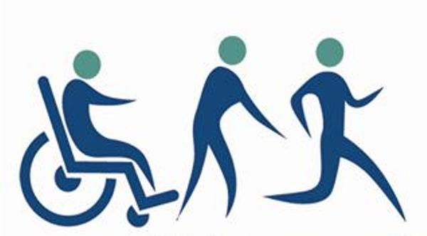
Our Philosophy

Slide 26

Anxiety... one of the most prevalent Mental Health Disorders
Anxiety is one of the most prevalent mental health disorders. 1 in 14 people in the world is likely to suffer from it. Anxiety is often the precursor to depression and very few people who need treatment actually receive it.

Slide 27
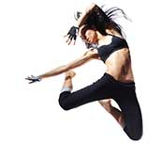
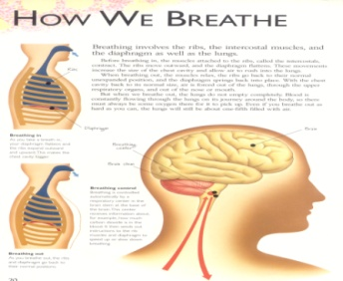
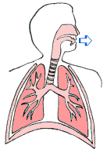

More Breath Per Breath Program
SAANS Power Breath
Breathe deeply with SAANS POWER breathe for more energy
Deep breathing reaches the deepest depths of your lungs, and by practicing SAANS POWER breathe inspiratory muscle training you’ll be training your respiratory muscles to breathe deeply into your diaphragm, taking in as much air as possible, breathing more in per breath. As you’re breathing in more air per breath, you’re receiving more oxygen into your body, giving you more energy. Senior consultant at the National heart Institute, India, and Founder, SAANS Foundation in India, Partha Pratim Bose offers a good example of this,
“By deep breathing exercises you breathe more per breath. If you breathe more per breath you expand your lungs more, you receive more oxygen. You will feel more energetic and also save your breaths. For example, if you breathe 250 ml per breath and your requirement is 5 liters then you need 20 breaths per minute. If you breathe more breath say double i.e. 500ml then you will require only ten breaths. So by breathing deep you breathe less and you feel better and conserve energy.”
Dr. Anthony Alessi, Associate Clinical Professor of Neurology at the University of Connecticut, wrote in an article in The Norwich Bulletin quoted SAANS Power Breath, 2017

Slide 28
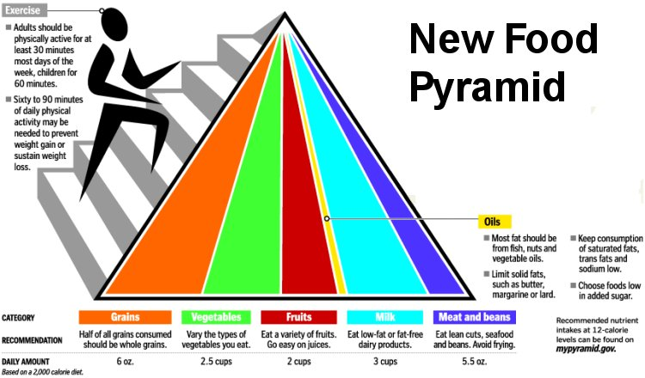
Nutrition

Slide 29
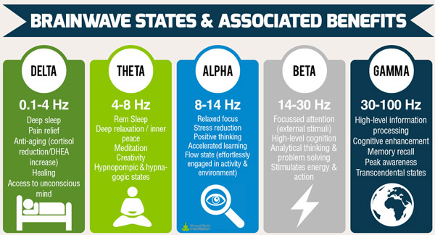

Binaural Frequencies

Slide 30

Our Goal

Slide 31
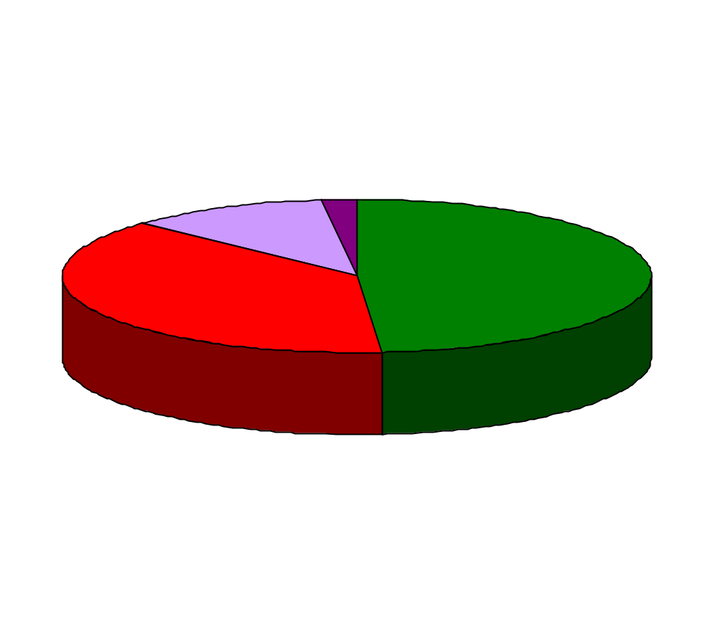
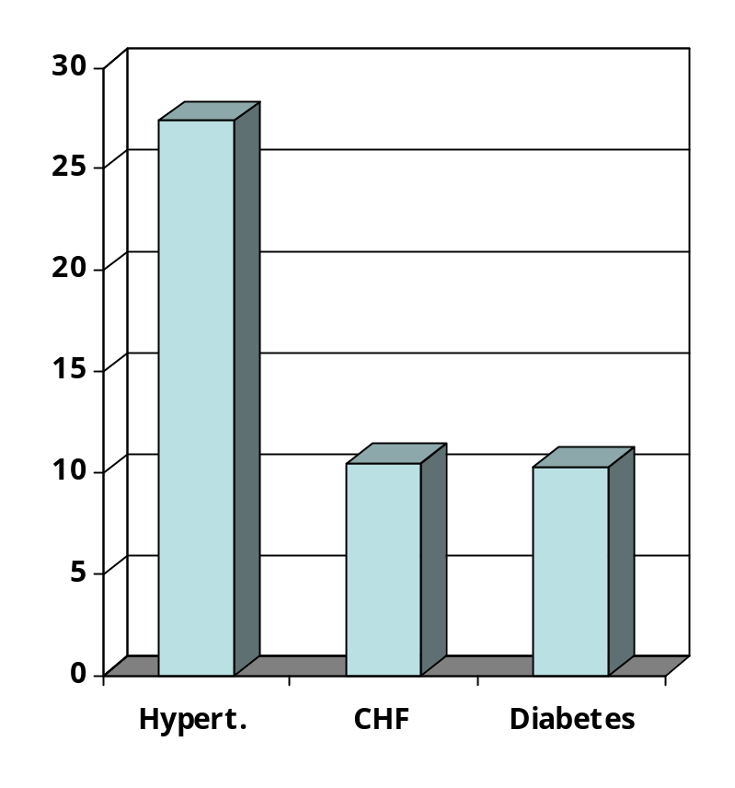
Co-morbidity management
>2
2
No
Screening/selection/entry
Prevalence (%)
1
Number of co-morbidities
Co-morbidity
CHF – Chronic heart failure
Crisafulli Thorax 2008

Slide 32
A COVID REHAB PROTOCOL

Slide 33

Algorithm for PR
Initial assessment
Clinical Evaluation, PFT, Dyspnea scores,
6 Minute Walk Test, QoL assessment
Prescribing PR
Psychological intervention
Nutritional intervention
Exercise training
Breathing training
Outcome assessment

Slide 34
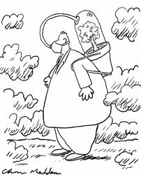
Oximetry and Six-minute walk test

Slide 35
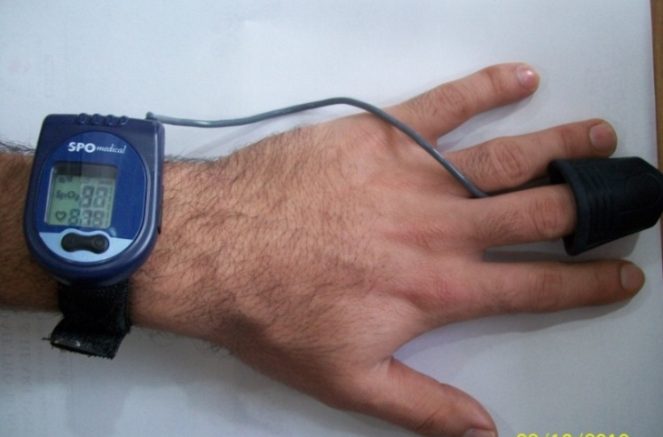
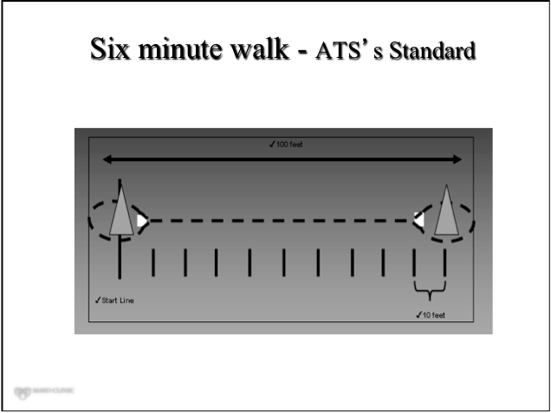
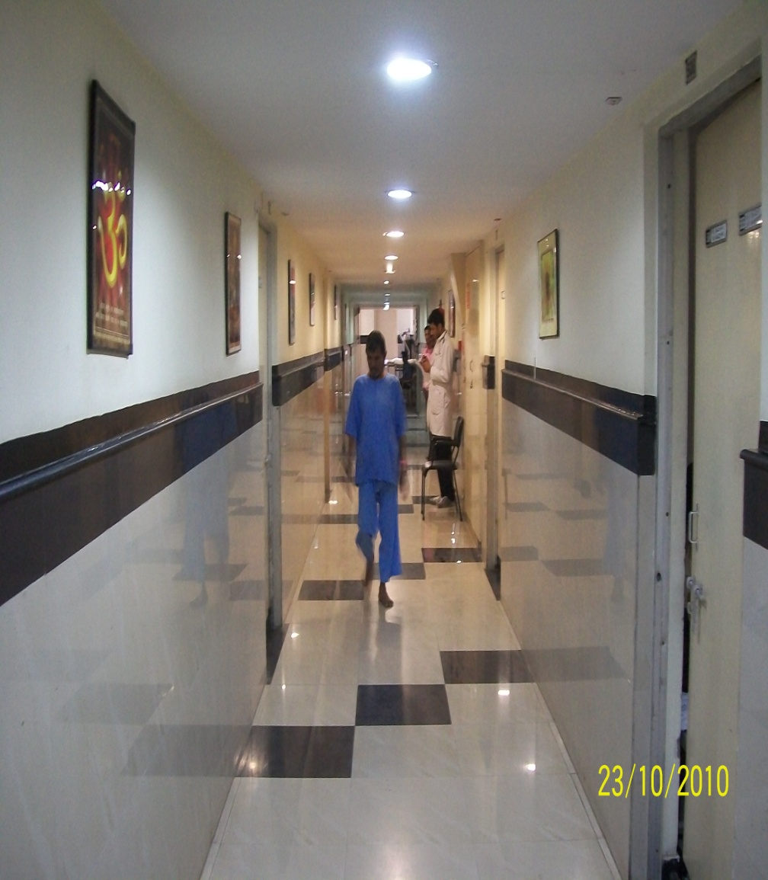
Six minute walk
Am J Respir Crit Care Med 2002;166:111–117

Slide 36
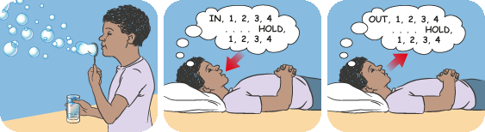
Breathing & Relaxation

Slide 37

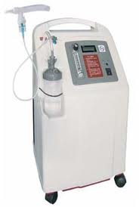
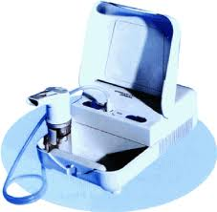
Device education

Slide 38
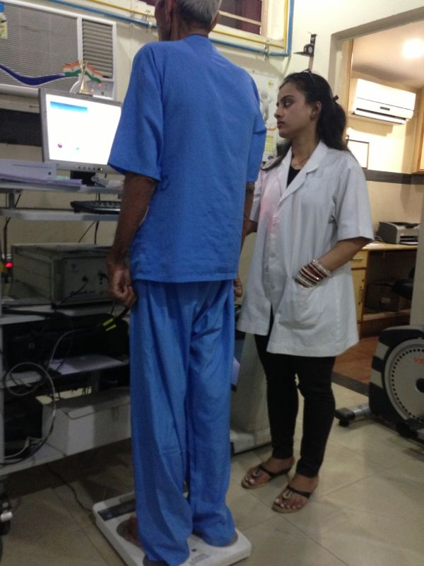
Nutrition Assessment
Height & Weight
BMI
Dietary History
Fluid intake / Exercise losses
Lean body mass determination
Serum albumin / pre albumin
Alcohol
Weight change
Malnutrition needs to be identified at the beginning
Notes:
To be only touched upon in this section, covered in detail by the nutritionist in respective section.

Slide 39
Nutrition

Slide 40

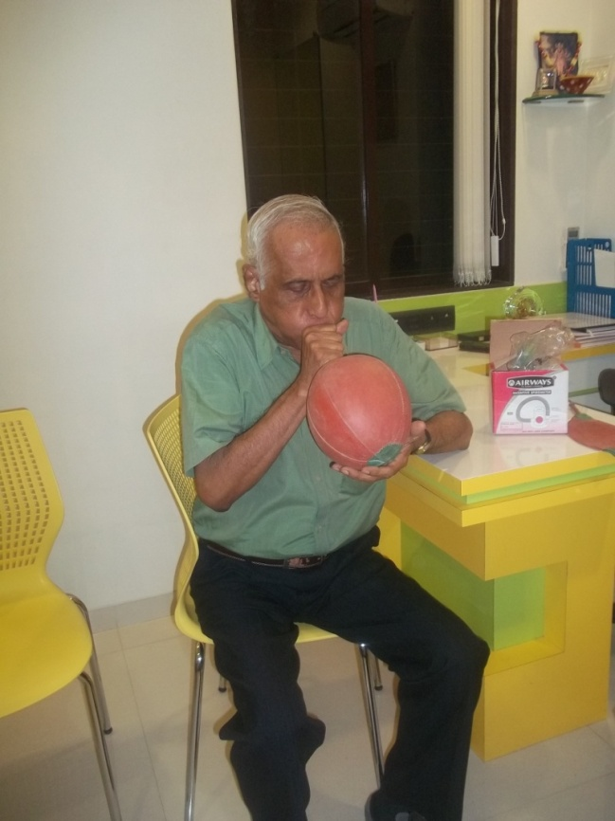
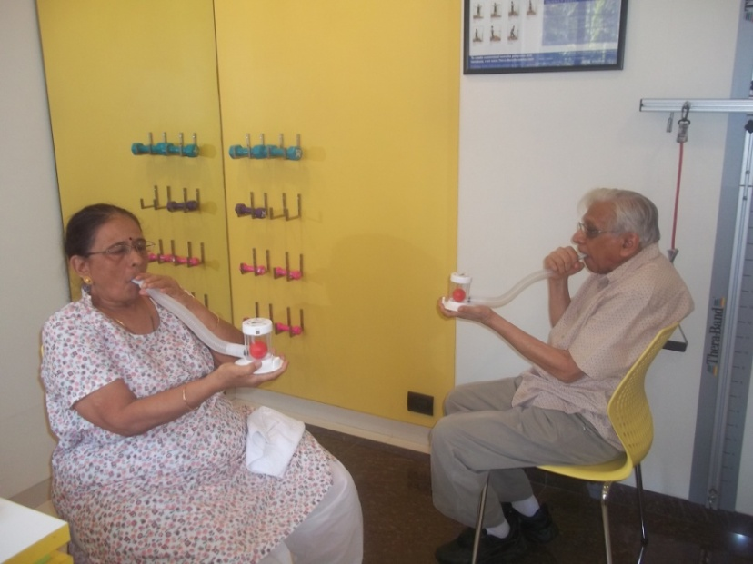
Breathing exercises
Notes:
Ballon bladder for expiratory exercise, 10 rep twice in a day, and incentive spirometer start with minimal 200cc, correct technique is very important, teach them properly, and tell how to progress, after holding ball up for 3sec then only progress to next level.

Slide 41
Saans Power breath

Slide 42
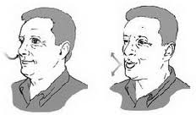
Breathing techniques
Pursed Lip Breathing
Segmental breathing exercises
Thoracic expansion exercises
Autogenic drainage
Postural drainage
Notes:
PLB - explain physiological mechanism, and more in demo, segmental and thoracic expansion exercises explain in demo, Autogenic drainage-
technique mostly used to remove secretion in sitting posture, explain physiology of technique , works on the principle of low lung volume, mid lung vol, high lung volume expiratory breathing end with huffing.
Postural drainage works on the principle of gravity, so more explanation in demonstration.

Slide 43
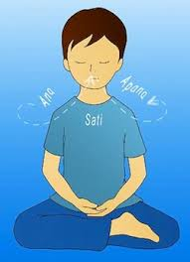
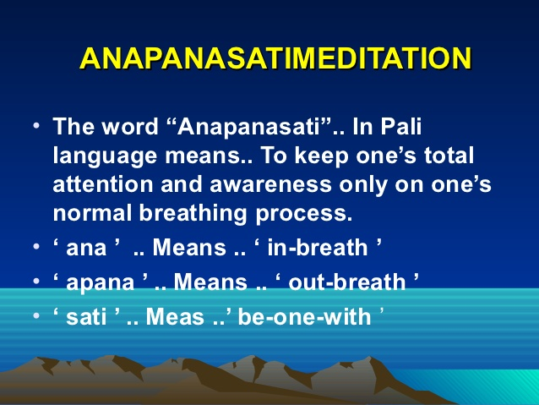
Watch your Breath

Slide 44
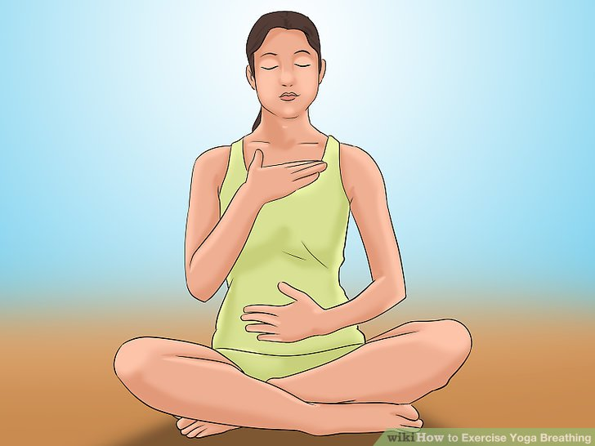
Feel your Breath

Slide 45
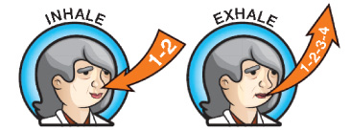
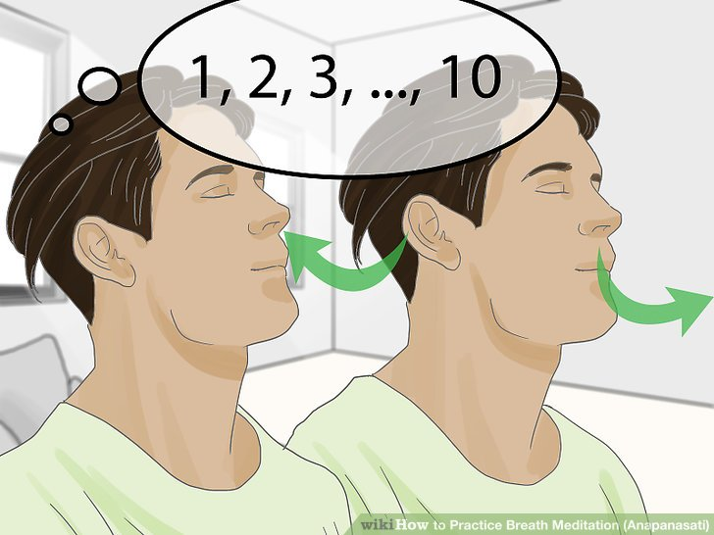
Watch your Breath

Slide 46
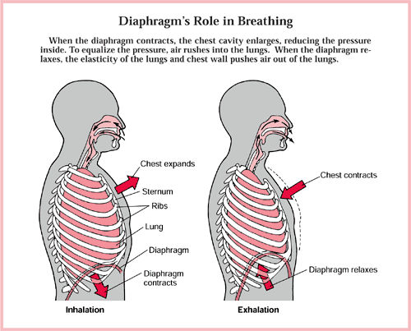
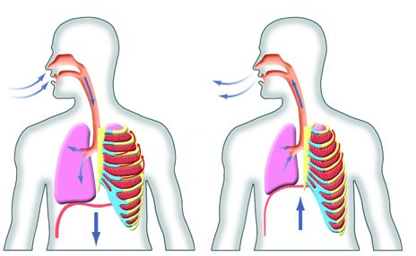
Diaphragmatic breathing

Slide 47
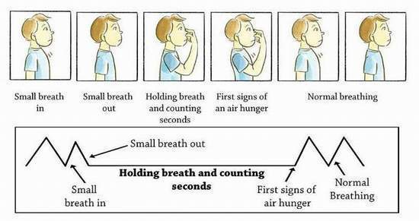
Buteyko breathing

Slide 48
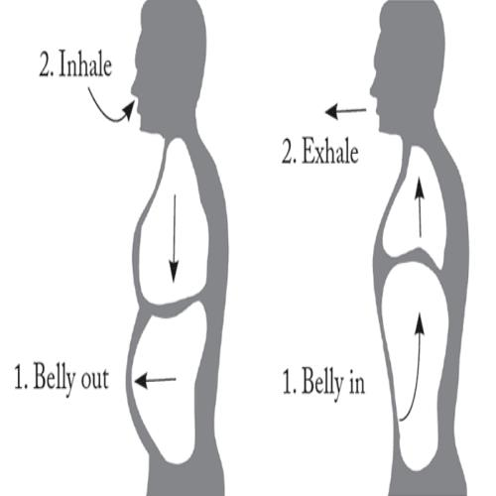

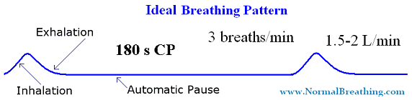
Buteyko Professional International Breathing Techniques

Slide 49
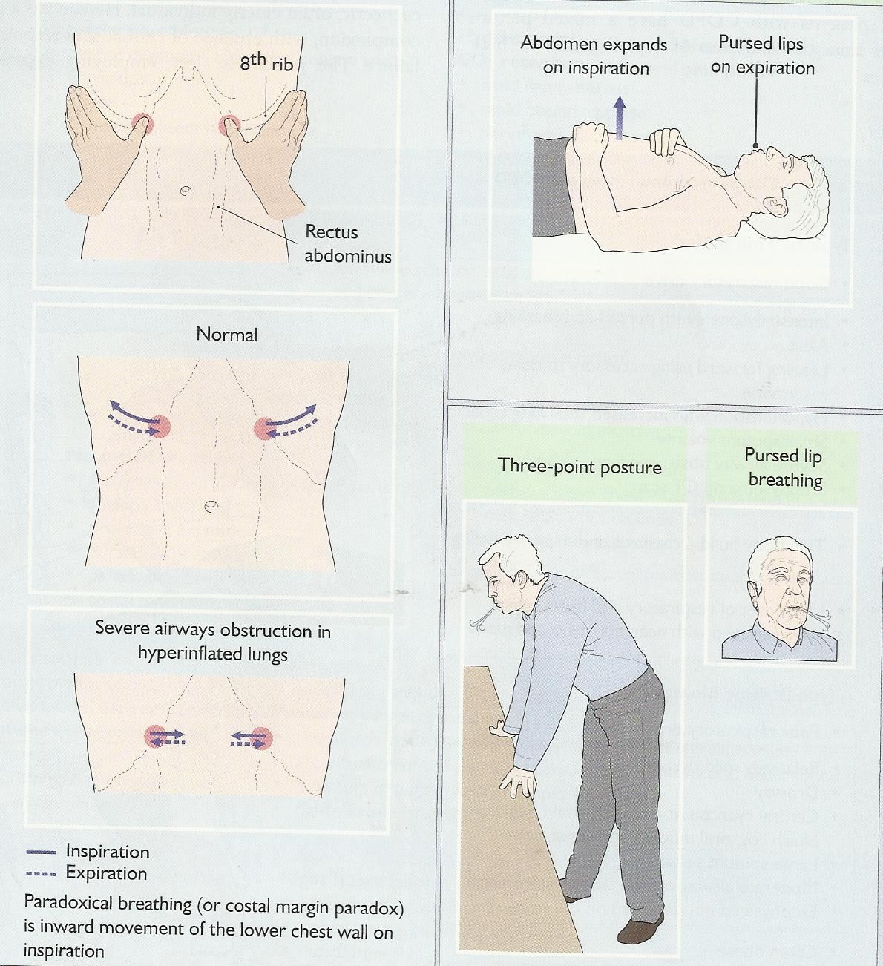
Diaphragmatic Breathing

Slide 50



Energy conserving

Slide 51
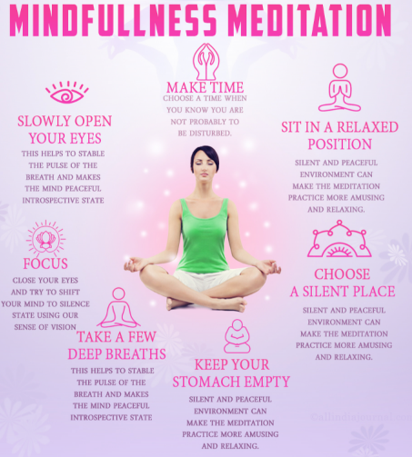
Guided Meditation

Slide 52


Slide 53
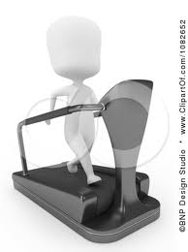
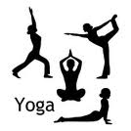
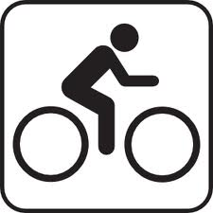
Muscle Reconditioning

Slide 54
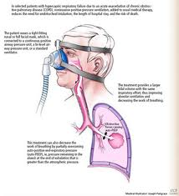
Non-invasive ventilation

Slide 55
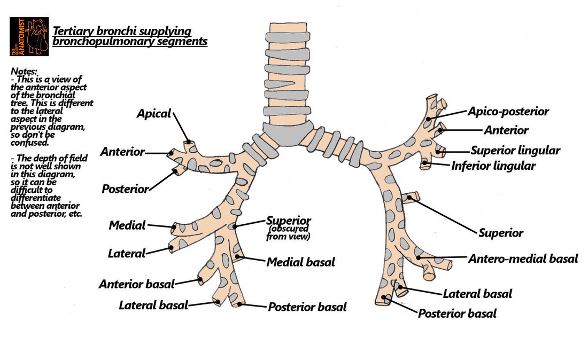
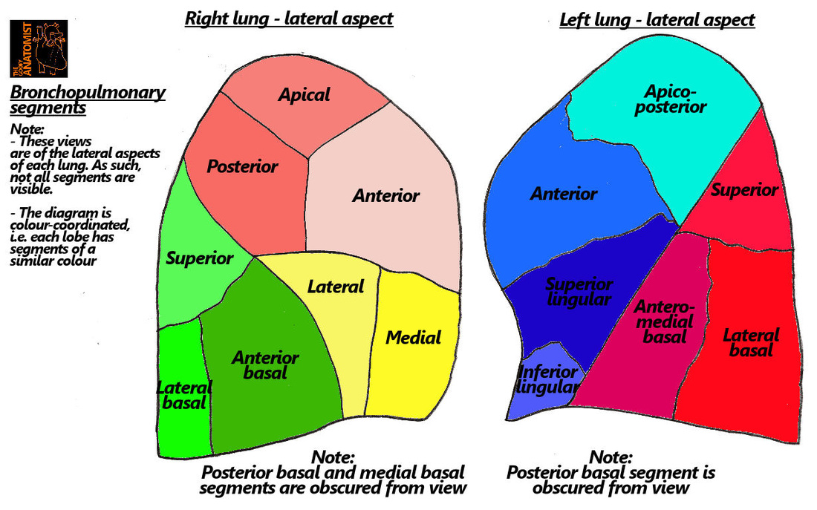
Understanding bronchopulmonary segments

Slide 56
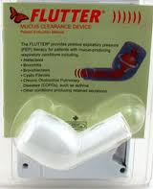
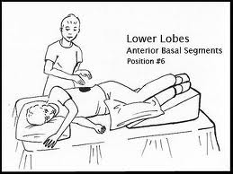
Mucus clearing and postural drainage

Slide 57
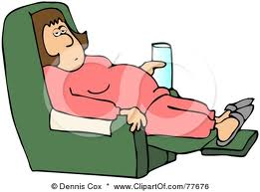
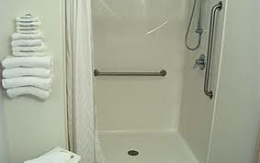

Lifestyle modification

Slide 58
Stretching Exercises for flexibility

Slide 59
Designing an exercise program
A pulmonary rehabilitation program must include, at minimum, lower limb endurance exercise training.
  Lower limb endurance training
  Home exercise program
Optimally, a pulmonary rehabilitation should also include:
  Upper limb endurance training
  Lower limb strength training
  Upper limb strength training
Other components that may be included are:
  Flexibility and stretching exercises
  Balance exercises
  Inspiratory Muscle training

Slide 60
Strength Training - Lower Limb
Strength training can improve
  muscle strength,
  peak work capacity and
  endurance time.

Slide 61
Strength training with weights:
  Leg press
  Quadriceps extension
Strength training without weights:
  Squats
  Straight leg raise
  Step-ups or stair climbing
  Sit-to-stand from progressively lower chairs

Slide 62
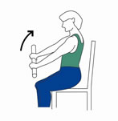

Low weight and high repetition
Notes:
Endurance training for upper limb-
start with minimal weight in form of dumbell or weight cuff e.g. 250 grams, 1 set= 10rep, increase no. of sets

Slide 63
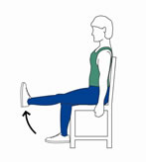
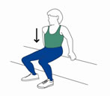
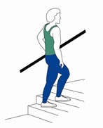
Lower Limb Strength Exercises
(high weight and low repetition)
Notes:
For lower limb strength- in assessment remove 10 RM of big muscles like quads, hamps, abductors, where patient should be able to perform action with maximum weight 10repitation.
Start training 60-80% of 10RM weight they can carry. and start training with that weight. 1 set=10-12 repetition, progress no of sets till 3.
Again check 10RM and increase weight in progression.

Slide 64
Strength Training- Upper Limb
Upper limb muscle strengthening is important as these muscles are used for everyday work.
Upper limb strength training results in moderate improvements in upper limb strength (o shea 2004)
A relationship has been shown between upper limb strength and upper limb work capacity for patients with COPD
Stronger upper limb muscles may help patients perform functional tasks (i.e. by enhancing the strength of the biceps and triceps muscles).
Notes:
Studies indicate that strength training for upper limb muscles results in moderate improvements in upper limb strength (o shea 2004)

Slide 65


Upper Limb Strength Exercises
(high weight and low repetition)
Notes:
Upper limb strength assessment- remove 10RM of big important muscles, like biceps, triceps, shoulder abductor, flexors.
Start training with 60-80% of 10 RM weight , 1 set-10-12 repetition, increase no. of sets up to 3 and Progress training with increasing weight after reassessment of 10RM of specific muscles.

Slide 66




3. Flexibility and Stretching
Notes:
Flexibility and stretching exercises can be included in warm up or cool down exercise set, exercise emphasizing on pectoral muscle or shoulder girdle muscle stretch and exercises concentrating on trunk mobility.,
shown in pictures, also concentrate on lower limb muscle flexibility and stretching which can help them in locomotion and endurance training.

Slide 67
Sample Program
Motivation & Six mt walk test
Breathing exercises ,chant Spirometry , IMT, PEEP
Mucus clearance
Steam, Postural drainage ,Cough Assist Device
Education
Disease, Devices, Oxygen, NIV
Nutrition Assessment
Aerobics Yoga, cycling, treadmill
2 to 3
times
per week

