Slide 1
COVID REHABILITATION & WELLNESS

Slide 2
COVID
Disease
Worsens
Co- Morbidity
SpO2 ↓
Blood Sugar ↑↑
HTN ↑
Fluid Imbalance
Metabolic Dysfunction
High Doses of Steroids
Oral Anti- Coagulant
Poor Nutrition
Immobilization
Deconditioning
Decreased Muscle Function
Atrophy
Early Rehab Phase- 1
Co- Morbidity Management
Nutrition Support & Counseling
Muscle Reconditioning
Upper airway and Bronchial Hygiene

Slide 3
COVID DISEASE
Perceptive
Objective
Hyperventilation Syndrome
Anxiety Neurosis
Phobia
Insomnia
Depression
Complication Management
Ventilator
Non Invasive Ventilator
Oxygen Therapy
Post COVID Fibrosis
Rehab Phase 2
Neurocognitive Rehab
CBT
REBT
Progressive Relaxation Techniques (PRT)
Acute Rehab
Vigorous Chest clearance techniques
Postural Drainage
Prone positioning
Chest clearance devices
Oxygen Therapy
I:E titration in case of NIV
Interphase Monitoring (NIV)
Nutritional Support
Breathing exercises
Early Mobilization and Muscle reconditioning (when off ventilatory support)
Rehab Phase 3
Pulmonary Rehab

Slide 4
Rehab Phase- 1
Co – Morbidity Management

Slide 5
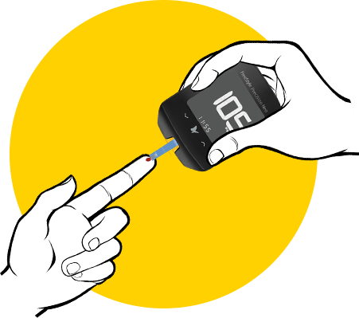

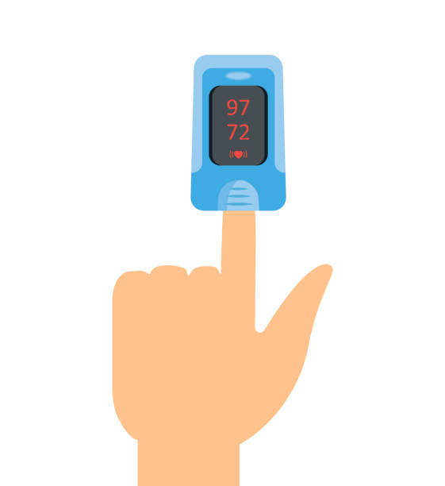
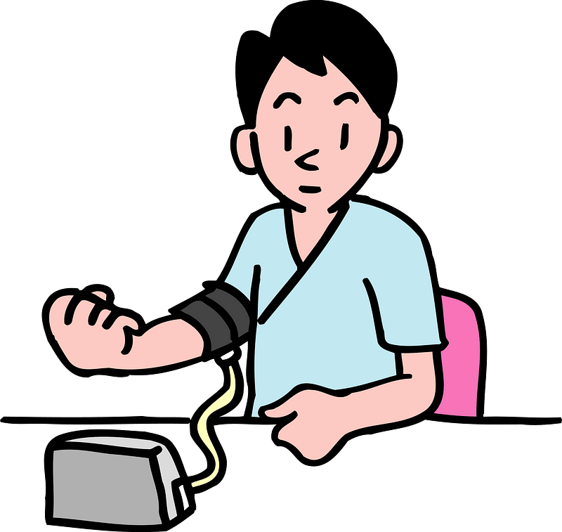
Blood Sugar Monitoring & DM Management
Fluid Imbalance management
SpO2 Monitoring & Oxygen Supplementation
Monitoring & Management of HTN

Slide 6
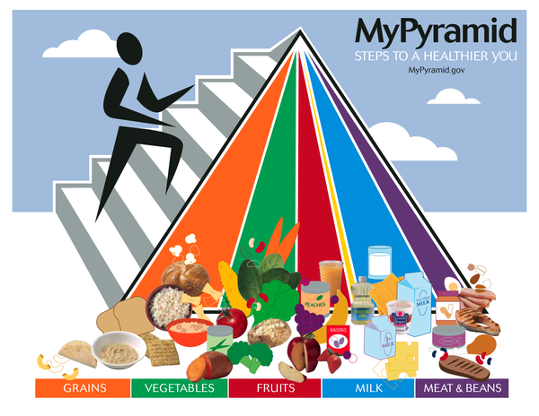

Nutrition Support & Counseling

Slide 7


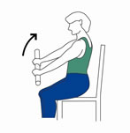
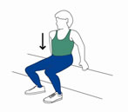
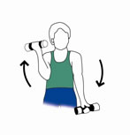
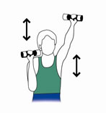
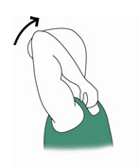
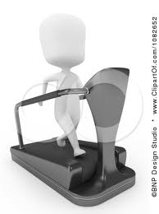

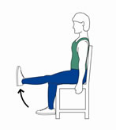
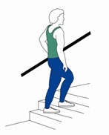
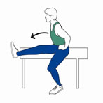
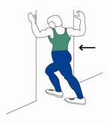

Muscle Reconditioning

Slide 8
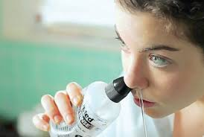
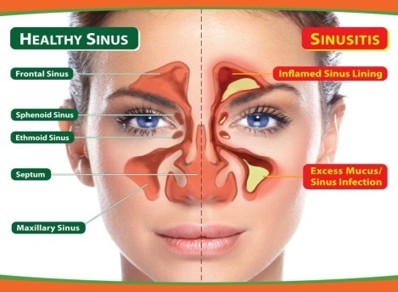

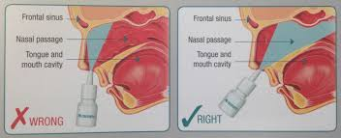
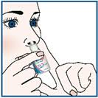
Upper airway and Bronchial Hygiene

Slide 9
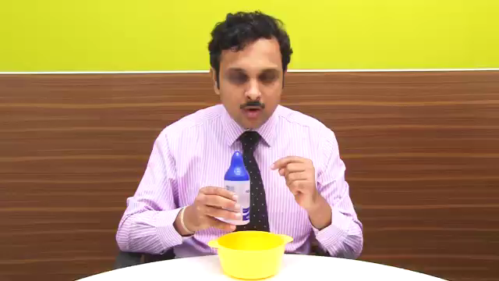
Nasowash

Slide 10
Rehab Phase- 2
Neuro-cognitive Management

Slide 11


Mental Wellness

Slide 12
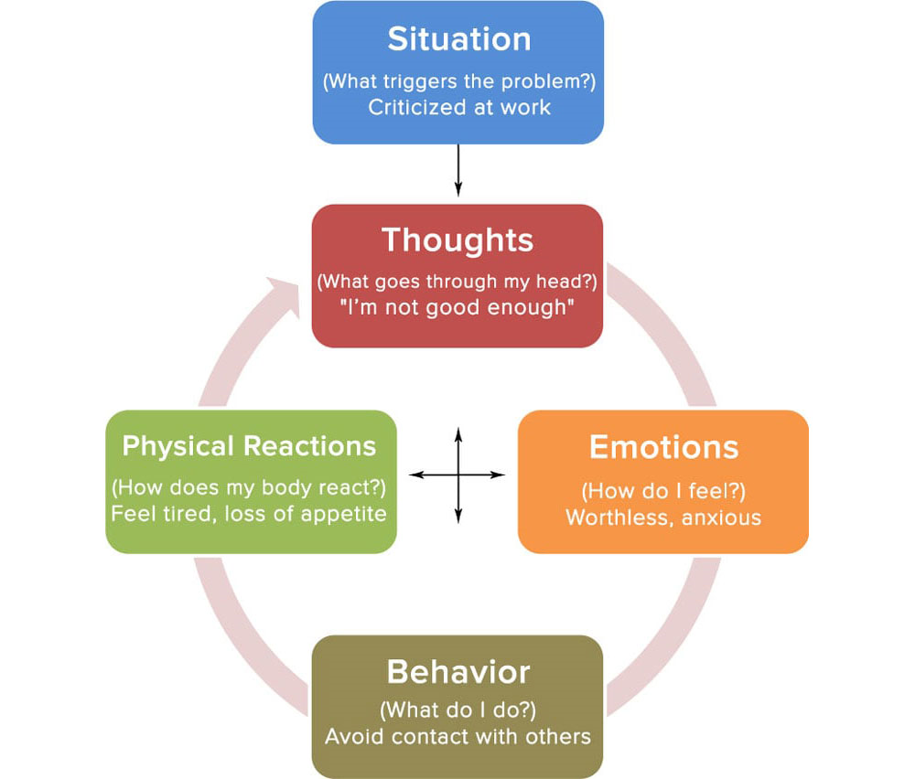
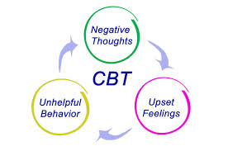
Cognitive Behavioural therapy

Slide 13

Guided Relaxation Technique

Slide 14
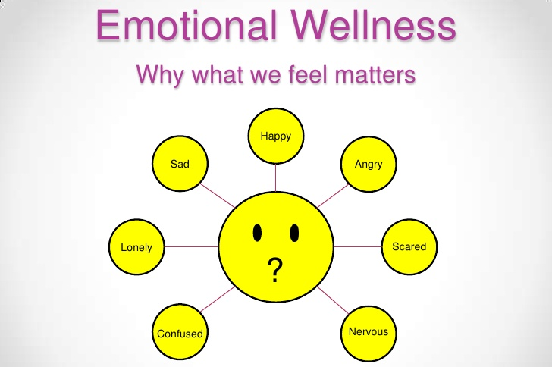

EMOTIONAL WELLNESS
Having a positive attitude, high self-esteem, a strong sense of self, and the ability to recognize and share a wide range of feelings with other in a constructive way.
Emotional Wellness Check
Evaluate your own emotional wellness with this brief quiz
Am I able to maintain a balance of work, family, friends, and other obligations?
Do I have ways to reduce stress in my life?
Am I able to make decisions with a minimum of stress and worry?
Am I able to set priorities?
If you answered "No" to any of the questions, it may indicate an area where you need to improve the state of your emotional wellness.

Slide 15


Slide 16

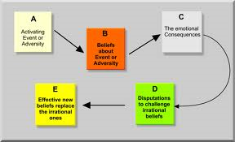
RATIONAL EMOTIVE BEHAVIOURAL THERAPY (REBT)

Slide 17
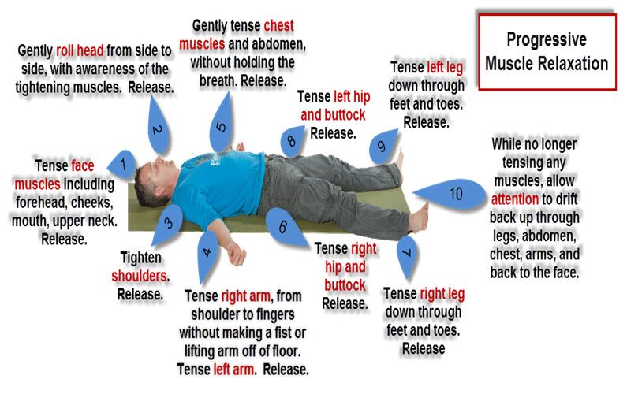
Progressive Muscular Relaxation Technique

Slide 18
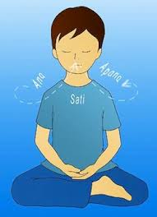
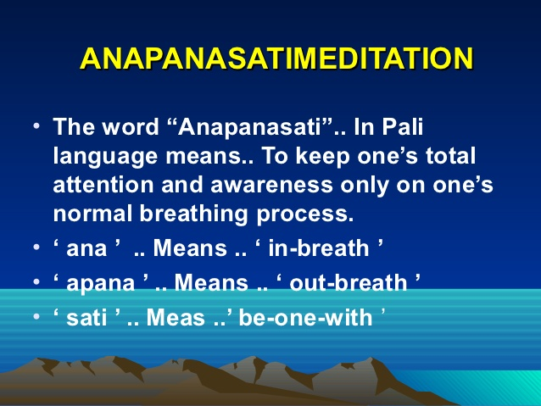
Watch your Breath

Slide 19
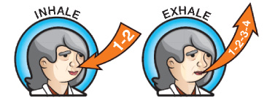
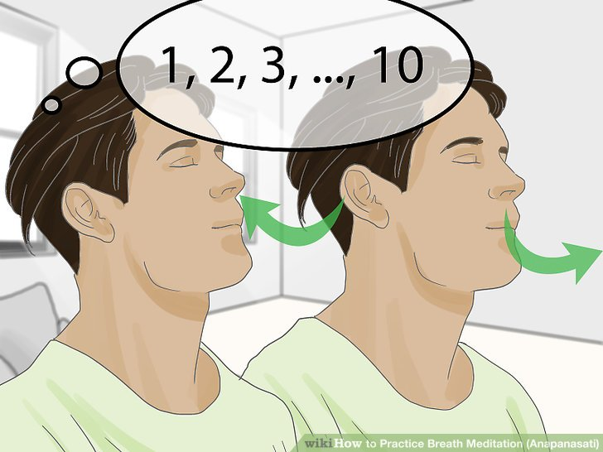
Watch your Breath

Slide 20
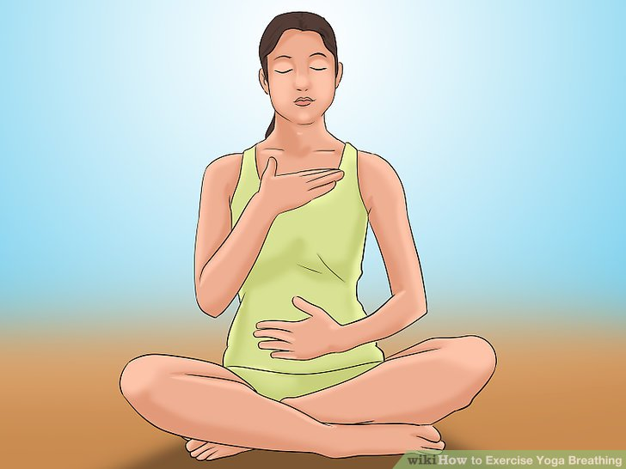
Feel your Breath

Slide 21
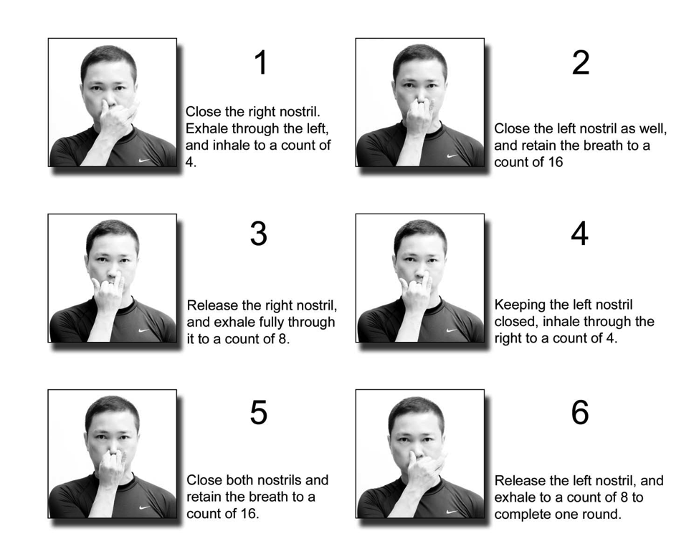
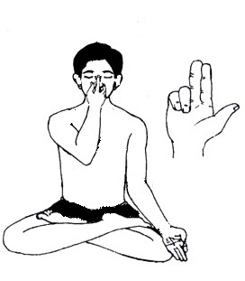
Anulom vilom

Slide 22
ACUTE REHAB
Crisis Management

Slide 23
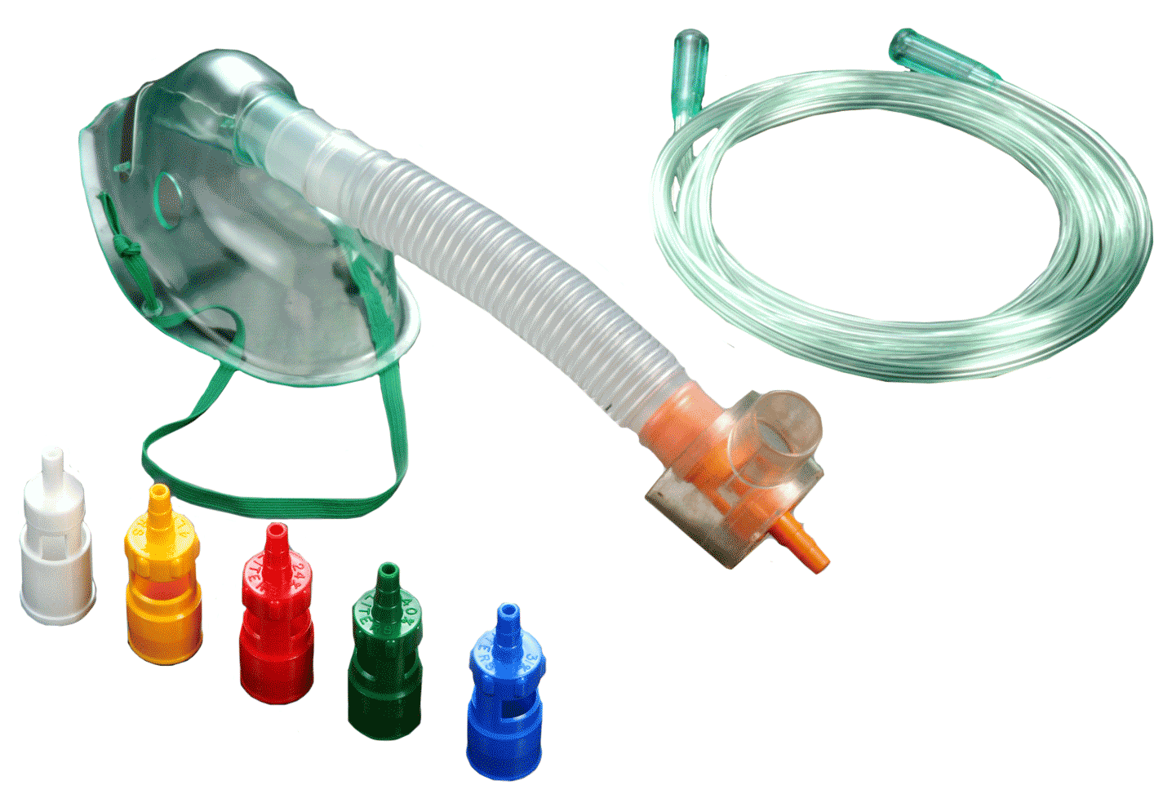
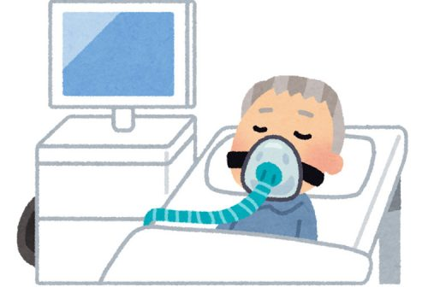
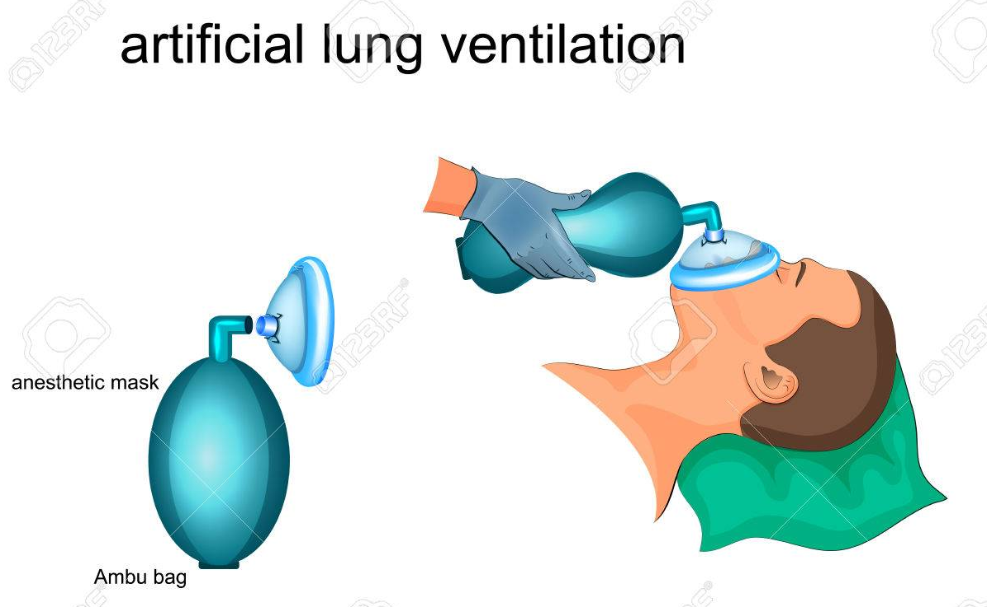

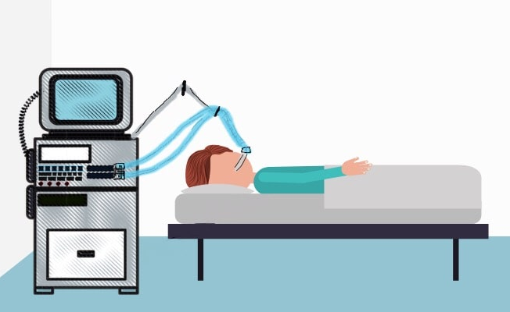
Ventilation & Oxygenation Strategies
Non-invasive ventilation
Oxygen Therapy
Mechanical Ventilation

Slide 24
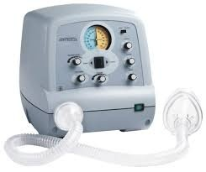
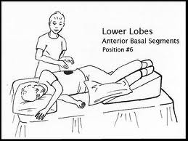
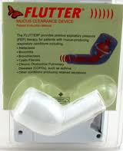
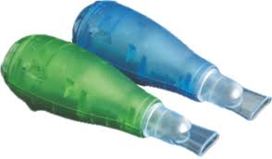
Mucus Clearing Devices And Postural Drainage
Cough Assist Device
PEP Device

Slide 25
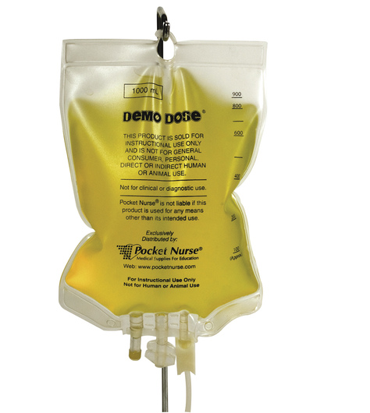
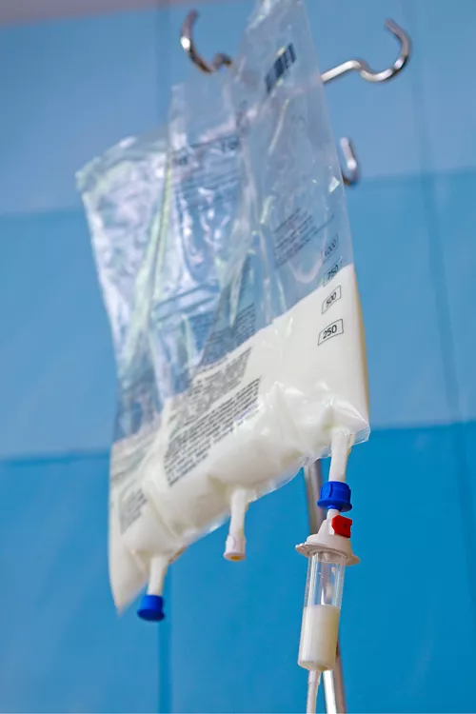

Nutrition Therapy
I/V Vitamin
Total Parenteral Nutrition

Slide 26
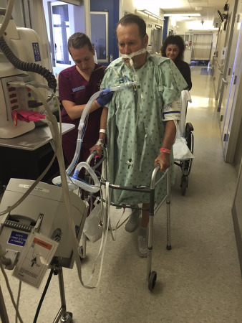
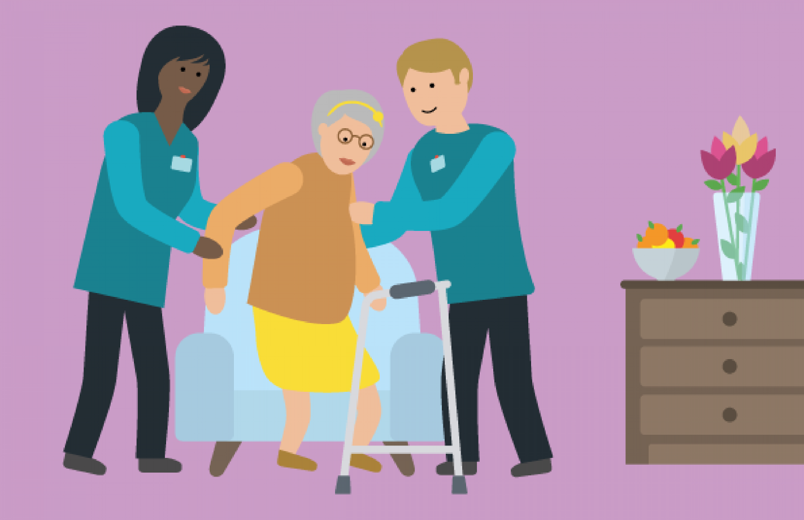
Early Mobilization

Slide 27
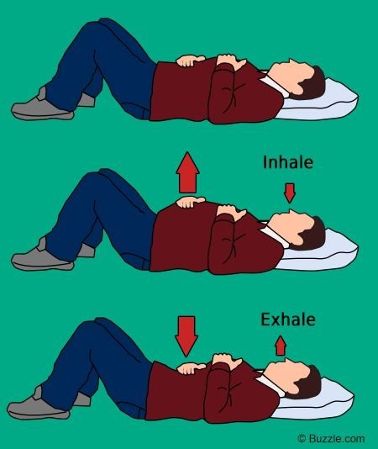
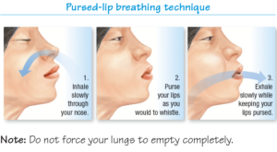
Breathing Techniques
Diaphragmatic Breathing

Slide 28
Rehab Phase-3
Pulmonary Rehabilitation for Post COVID Fibrosis

Slide 29
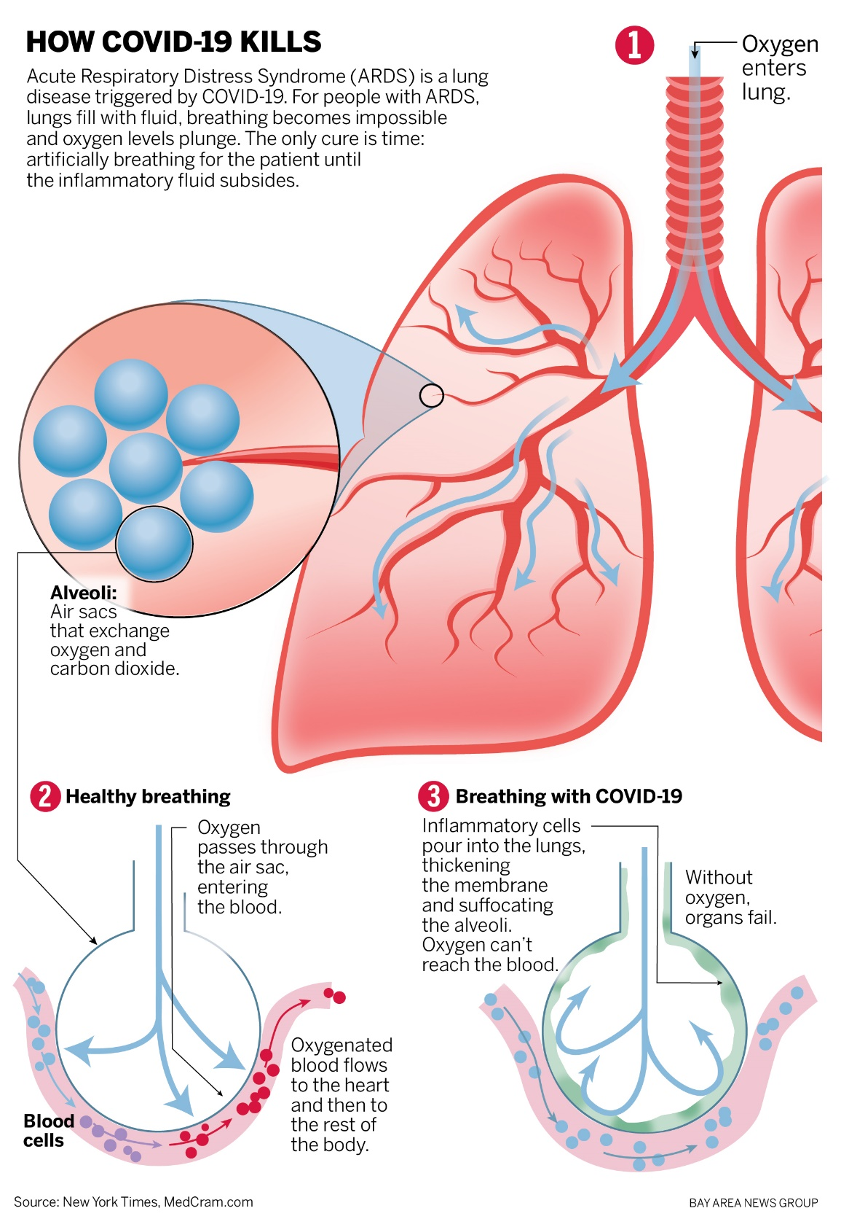

Slide 30
Components of a Comprehensive Program
Assessment
Education
Exercise Training
Psychosocial/Behavioral intervention
Nutrition
Breathing techniques
Medications, devices & specific therapy
Outcome Assessment
Notes:
These interventions are provided by a multidisciplinary team that often includes physicians, nurses, respiratory therapists, physical therapists, occupational therapists , dieticians and social workers.

Slide 31
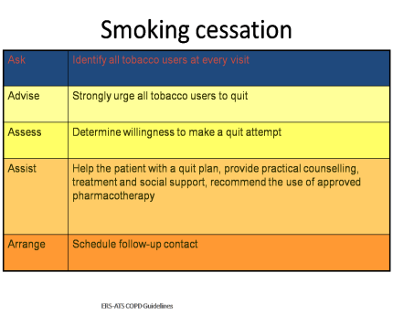
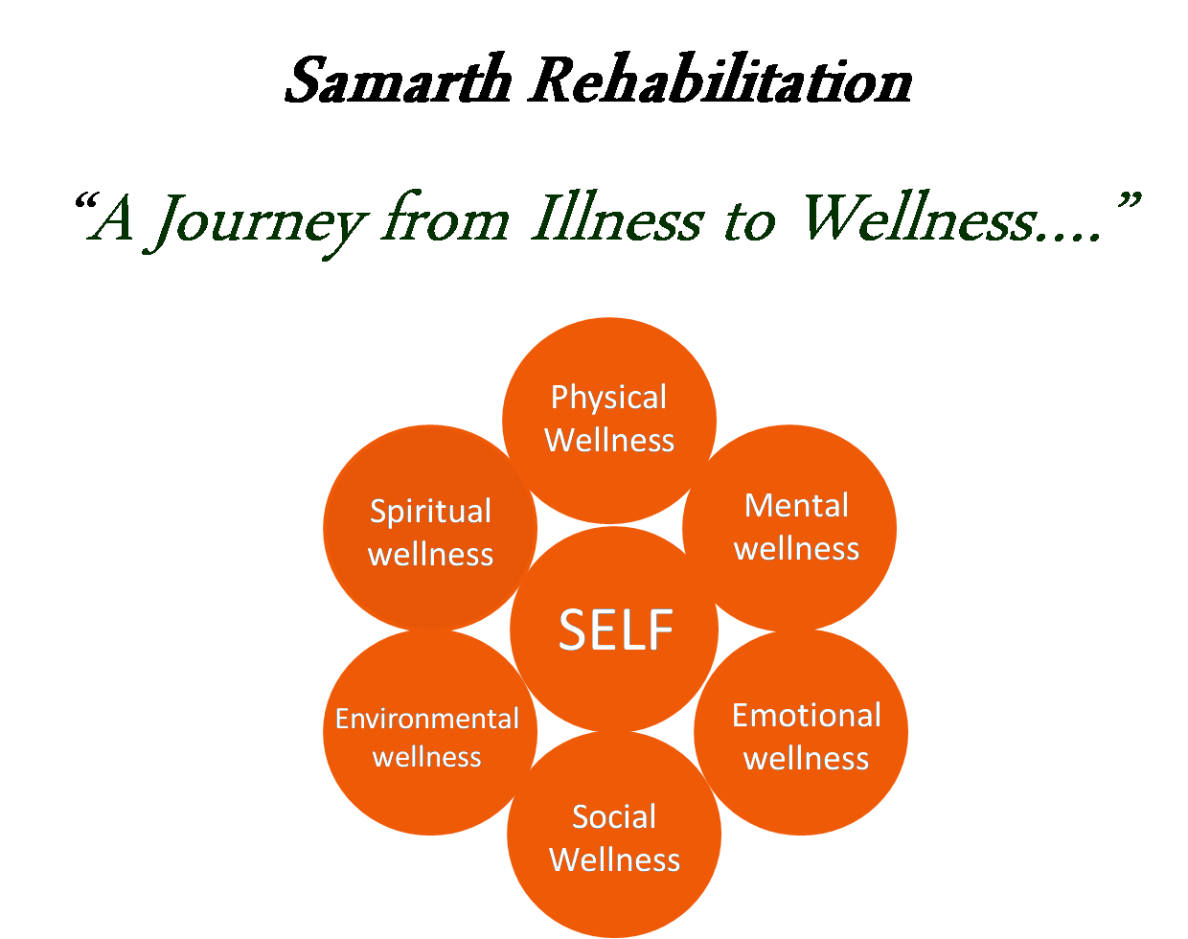
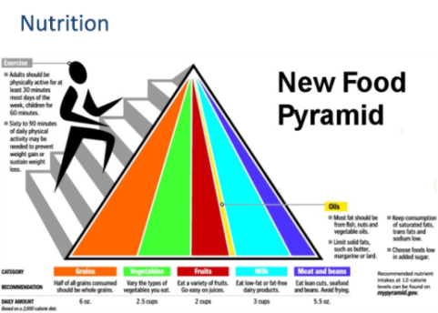
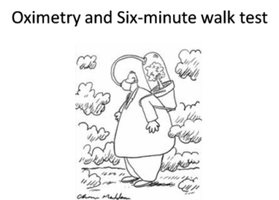








Pulmonary Rehabilitation
MOTIVATION
NIV

Slide 32
KEY POINTS:
POST COVID CHECK LIST
SYMPTOMS –COUGH/ BREATHLESSNESS /WEAKNESS
6 MINUTE WALK TEST
PSYCHOMETRIC QUESTIONNAIRE
PFT
HRCT
RESPIROMETER/PEP DEVICES/IMT
EXERCISES REGIMEN- STRENGTH AND ENDURANCE TRAINING
NUTRITIONAL COUNSELLING
CBT/REBT/ MOTIVATION SESSION
SLEEP MANAGEMENT
BRONCHIAL HYGIENE TECHNIQUES – STEAM INHALATION, NASOWASH, ACTIVE COUGHING , HUFFING etc
PROPER MEDICATIONS, INHALERS (with correct technique), ANTIFIBROTICS etc
PROPHYLACTIC VACCINATION – FLU, PNEUMONIA

