Slide 1



Dr P P Bose
MD, DTCD, DNB, FISDA, FBPI
Founder SAANS-SAKSHAM
Medical Director & Dean, Lords Institute of Medical Sciences
Senior Consultant, National Heart Institute
Visiting Consultant, Max Superspeciality hospital
http://www.saansfoundationindia.com/

Slide 2

Overview of Pulmonary Rehabilitation

Slide 3
What is Pulmonary Rehabilitation?
“A comprehensive intervention based on a thorough patient assessment followed by patient-tailored therapies which include, but are not limited to, exercise training, education and behavior change, designed to improve the physical and psychological condition of people with chronic respiratory disease and to promote the long-term adherence to health-enhancing behaviors.”
Singh et al. JAPI February 2012;60: 48-52

Slide 4
Rehabilitation
Rehabilitation is a comprehensive intervention for patients with chronic diseases who are symptomatic and often have decreased daily activities. It is designed to reduce symptoms, optimize functional status, increase participation, and reduce health care costs through stabilizing or reversing systemic manifestations of the disease.

Slide 5

History
Barach 1950s: Columbia University New York
Petty 1960s: University Hospital of Colorado-A Comprehensive Care Program for Chronic Airway Obstruction.
1974: 1st definiton from the ACCP
1980s: Some doubts
1990s: Definite beneficial adaptations
Casaburi R. Respir Care 2008;53(9):1185–1189.
Notes:
In mid fifties the common wisdom was that, since dyspnea on exertion was a major troubling symptom, avoiding dyspnea was appropriate disease management. A contrary opinion was offered by Barach, who, starting in the 1950s, offered important insights. Barach was a physician affiliated with Columbia University in New York.
To quote from a paper he wrote in 1952 “In 2 patients with pulmonary emphysema in whom dyspnea on exertion was relieved during inhalation of oxygen, an exercise program was instituted with subsequent marked improvement of capacity to exercise without oxygen. . . The progressive improvement in ability to walk without dyspnea suggested that a physiological response similar to a training program in athletes may have been produced.” (Casaburi R, 2008)
It would be 40 years before a physiological training effect would be demonstrated conclusively in COPD; but Barach clearly understood the concept in 1952 (Casaburi R, 2008).
In the late 1960s, Petty, working at the University of Colorado, brought together a team and established a standardized out-patient program of pulmonary rehabilitation. This program offered patients individualized instruction about their disease; taught about bronchial hygiene; utilized breathing retraining, physical reconditioning, and individualized pharmacologic therapy; and employed supplemental oxygen (as indicated, mostly for right-heart failure). By 1969 he had accumulated enough experience to publish the landmark paper “A Comprehensive Care Program for Chronic Airway Obstruction,” (Casaburi R, 2008)
In 1974, the American College of Chest Physicians formulated a definition of pulmonary rehabilitation .(Casaburi R, 2008)
In the 1980s doubts surfaced as to the ability of rehabilitative exercise to improve muscle function in COPD (Casaburi R, 2008). During this period some studies showed no significant benefit (Sharma 2011).
But in the 1990s studies showed that well-designed exercise programs caused beneficial physiologic adaptations (Casaburi R, 2008).

Slide 6
Current evidence
Cochrane review of 31 RCTs
  Rehabilitation
  relieves dyspnea and fatigue,
  improves emotional function and
  enhances patients’ sense of control over their condition.
Improvements are moderately large and clinically significant
Rehabilitation forms an important component of the management of COPD
Lacasse Y, GoldsteinR, LassersonTJ, Martin S. Cochrane Database of Systematic Reviews 2006, Issue 4. Art. No.: CD003793. DOI: 10.1002/14651858.CD003793.pub2.

Slide 7
Philosophy
Rehabilitation tries to address morbidities and their consequences through education and exercise. Patients are encouraged to become more actively involved in their own health care, more independent in ADLs and less dependent on health professionals and expensive medical resources. Rather than focusing solely on reversing disease processes, rehab attempts to reduce symptoms and make individual more functional

Slide 8
Purpose
Restore function following an illness or injury, with the goal of maximizing a person’s ability to achieve fullest life possible

Slide 9
Components of a Comprehensive Program
Education
Exercise Training
Psychosocial/behavioral intervention
Nutrition assessment
Breathing techniques
Medications, devices & specific therapy
Outcome Assessment
Notes:
These interventions are provided by a multidisciplinary team that often includes physicians, nurses, respiratory therapists, physical therapists, occupational therapists , dieticians and social workers.

Slide 10
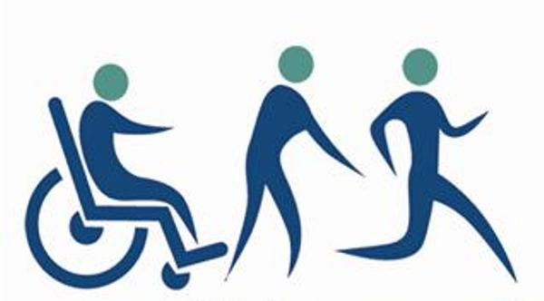
Our Philosophy

Slide 11

We believe

Slide 12

Our Goal

Slide 13
Methods: ASK
    ATTITUDE
    SKILL
    KNOWLEDGE

Slide 14
Attitude decides the Altitude

Slide 15
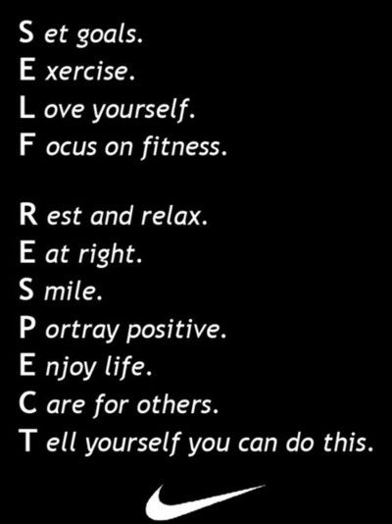
Our Key Word

Slide 16


Slide 17
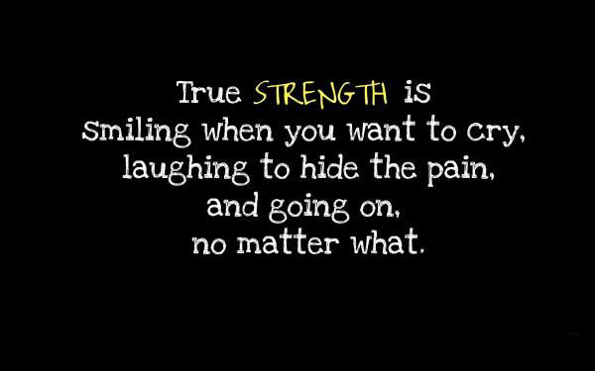

Slide 18
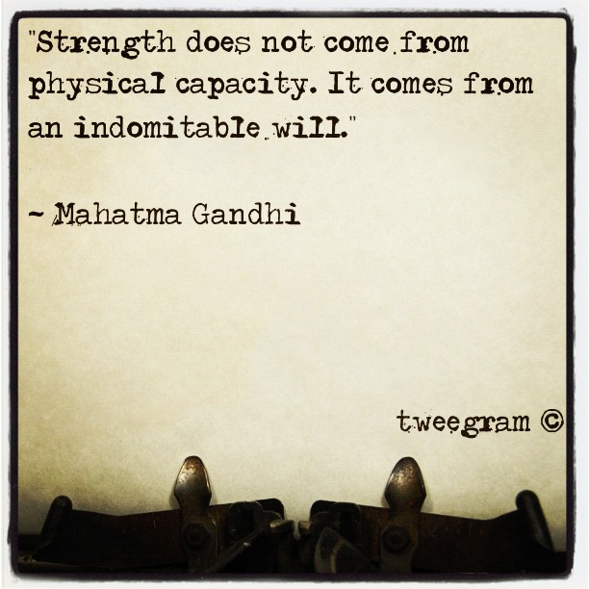

Slide 19
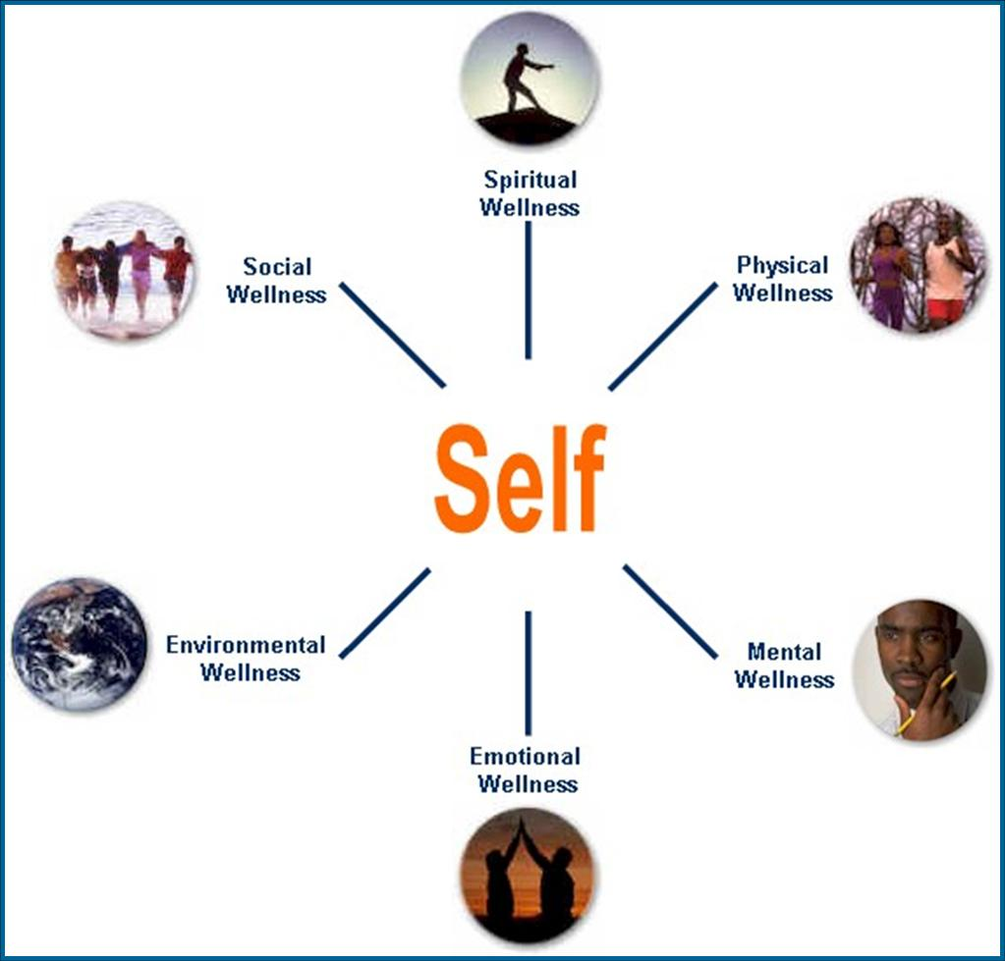
We Preach
360 degree Wellness

Slide 20
We Believe in Knowledge

Slide 21
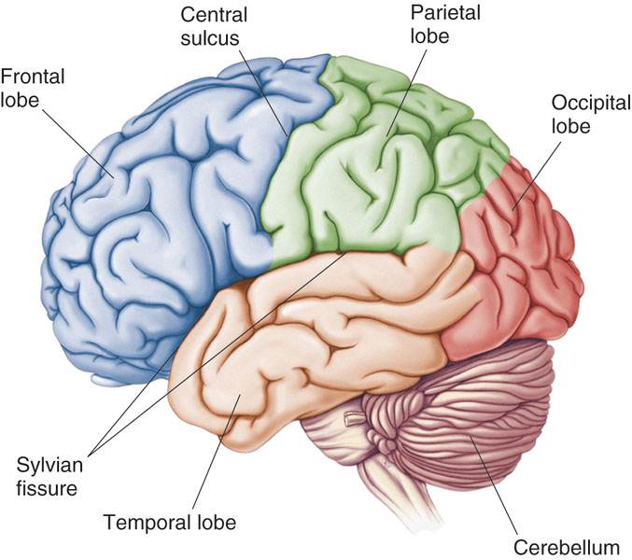
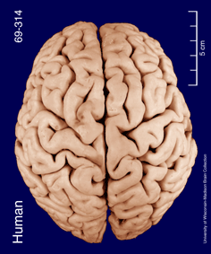
Specific Sulci/Fissures:
Central Sulcus
Longitudinal Fissure
Sylvian/Lateral Fissure
Transverse Fissure
http://www.bioon.com/book/biology/whole/image/1/1-8.tif.jpg
http://www.dalbsoutss.eq.edu.au/Sheepbrains_Me/human_brain.gif

Slide 22
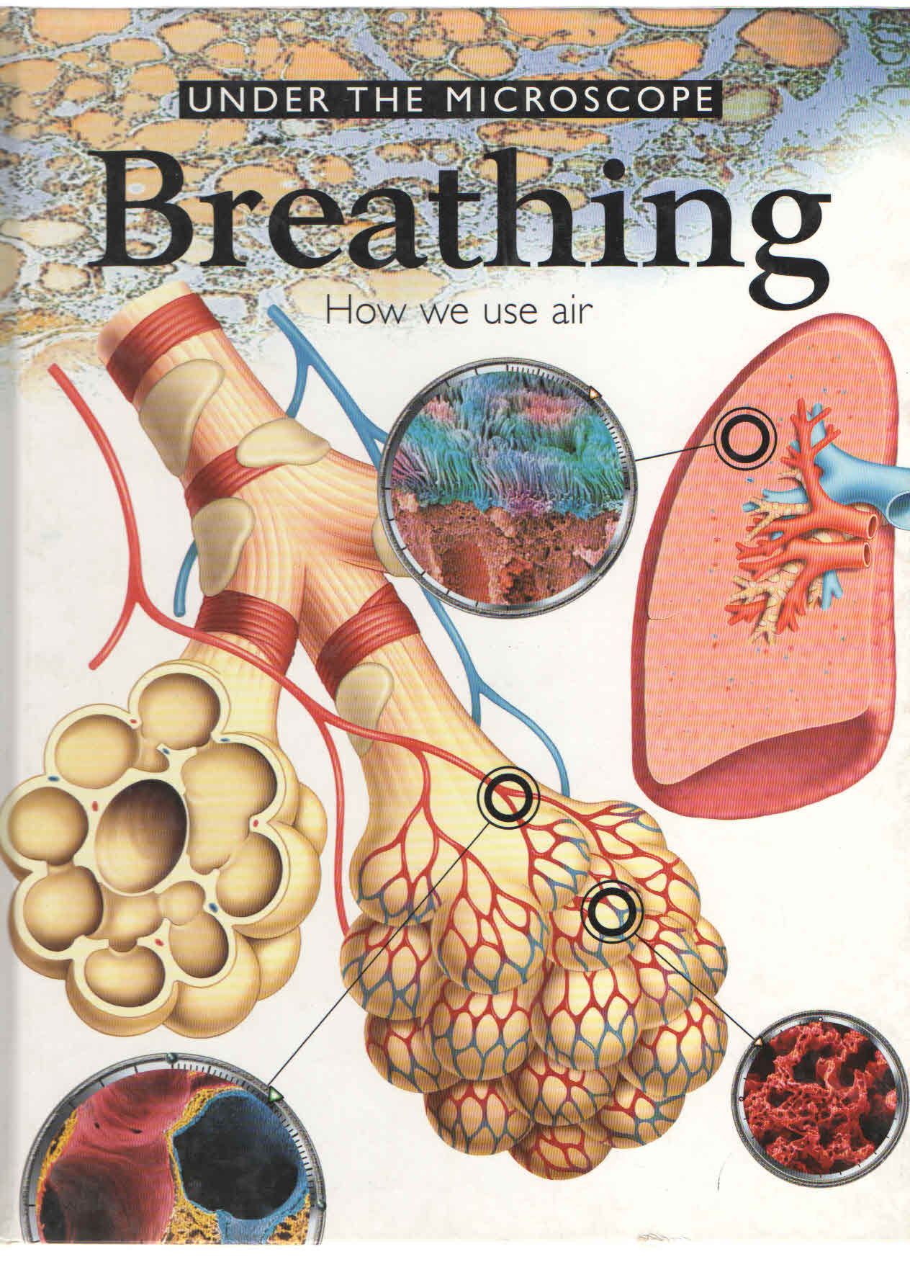

Slide 23
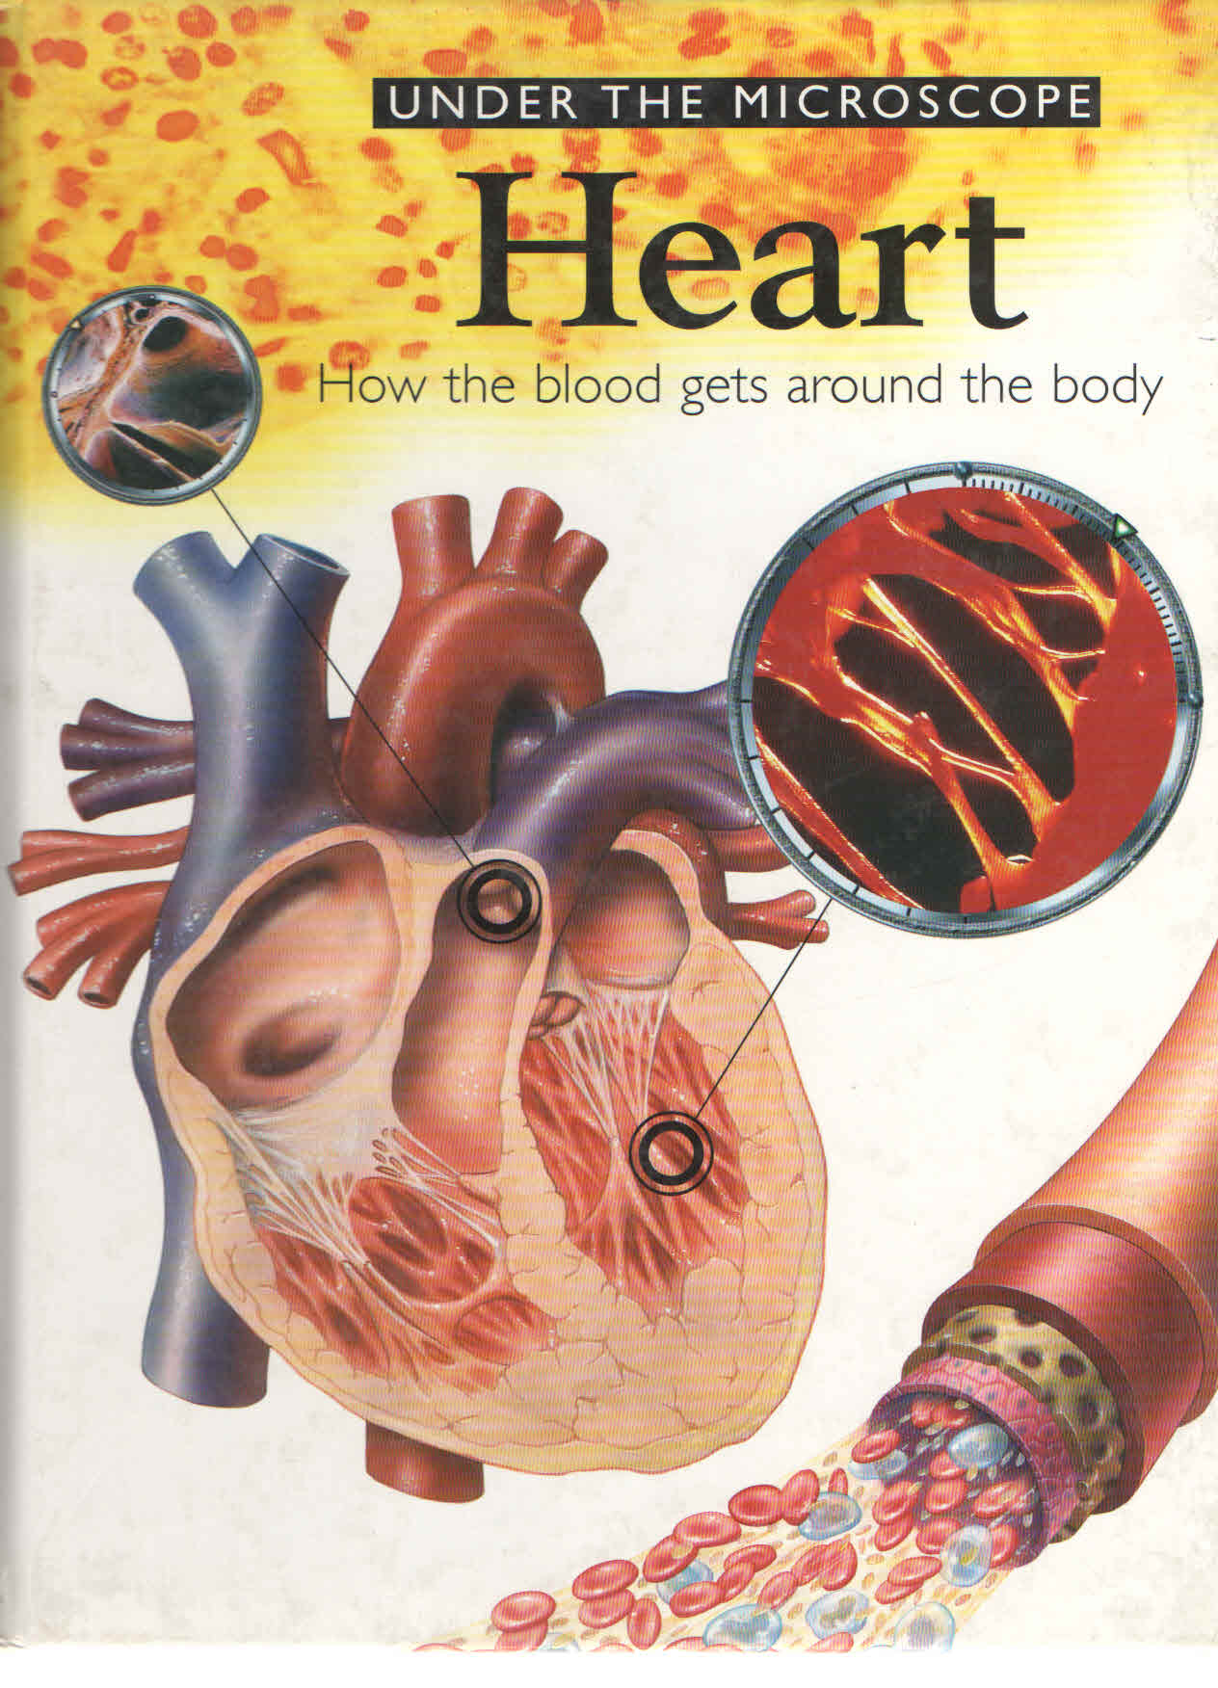

Slide 24
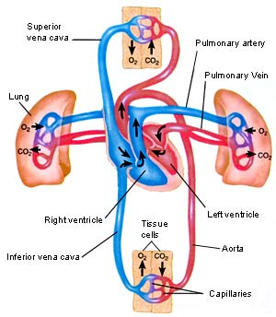

Slide 25
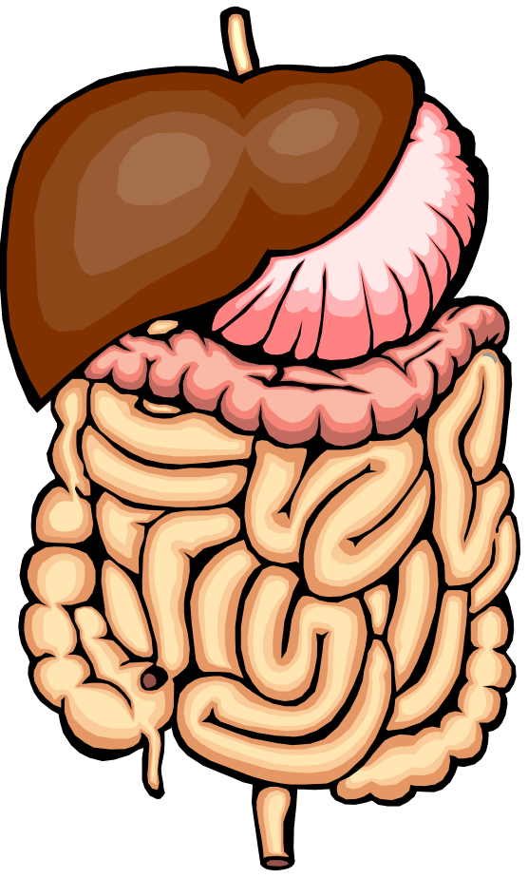
Components
Esophagus
Stomach
Small Intestine
Large Intestine
Gall bladder
Liver
Pancreas

Slide 26
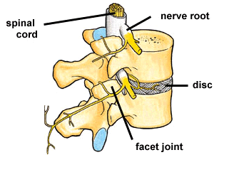

Slide 27
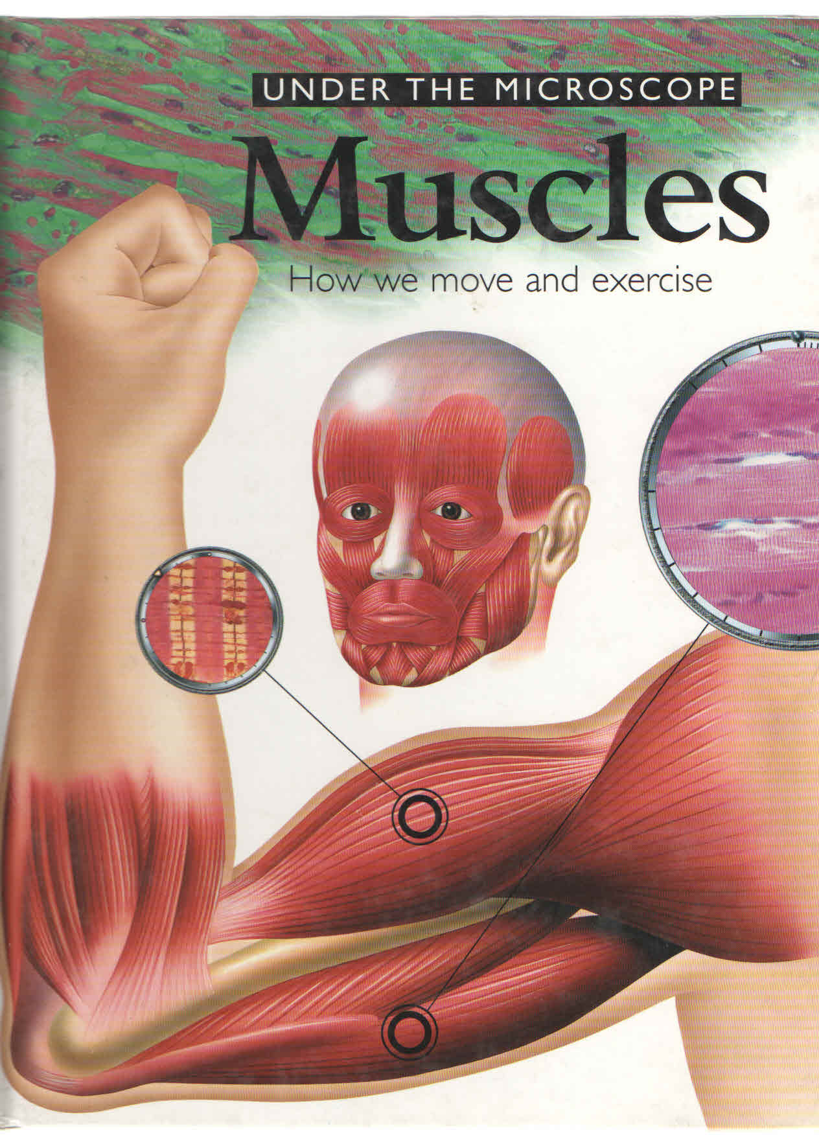

Slide 28
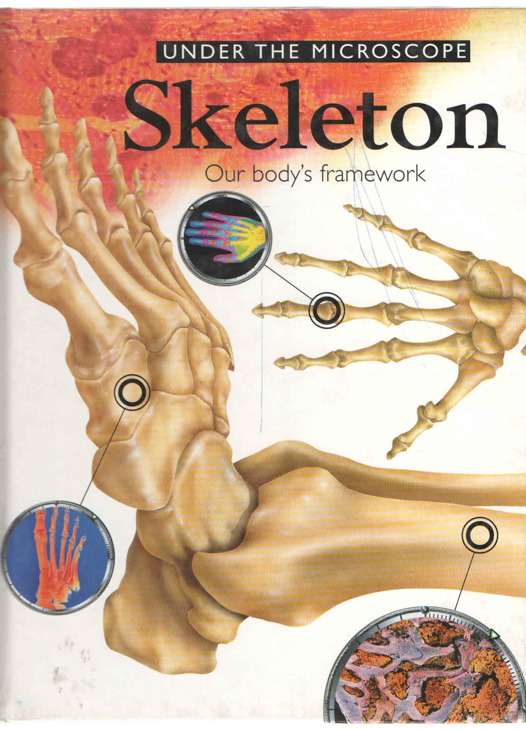

Slide 29
We motivate thru
Strength
Weakness
Opportunity
Threats

Slide 30
Aims & Objectives
  Prevent & treat medical problems
  Maximize functional independence
  Resumption of pts pre-existing lifestyle
  Reintegrate patient into home & community
  Enhance quality of life
  Facilitate psychosocial adaptation

Slide 31
Who can benefit?
Chronic respiratory disease symptomatic with optimum drug therapy
Chronic cardiovascular diseases with breathlessness despite optimum intervention and drug therapy
Chronic neurological diseases
Chronic orthopaedic diseases& post operative
Lifestyle disoders like Stress,Sleep , Obesity
Special children

Slide 32
Consequences of advanced chronic diseases
Peripheral Muscle dysfunction
Respiratory muscle dysfunction
Nutritional abnormalities
Cardiac impairment
Skeletal disease
Sensory defects
Neuro cognitive dysfunction
Psychosocial dysfunction
Notes:
To understand how and why Pulmonary Rehabilitation is an optimal treatment for Chronic Lung disease you must understand the consequences of respiratory disease on the body as a whole.

Slide 33
Mechanisms for these morbidities
Deconditioning
Malnutrition
Effects of hypoxemia
Steroid myopathy
Hyperinflation
Diaphragmatic fatigue
Psychosocial dysfunction from anxiety, guilt, dependency and sleep disturbances.

Slide 34
Benefits
Improved Exercise Capacity
Reduced perceived intensity of dyspnea
Improve health-related QOL
Reduced hospitalization
Reduced anxiety and depression
Improved limb function
Benefits extend well beyond immediate period of training.
Notes:
Several impairments such as weakness, dysfunction of skeletal and respiratory muscles, anxiety and depression and abnormalities in nutrition have responded to treatment. Improvement in overall and exertional dyspnea and QOL have been demonstrated. Significant increases in maximum exercise capacity have been observed.. Trials have indicated a decrease in health resource use. No trials have documented a survival benefit.

Slide 35
Spiral of disability
Increasing Breathlessness
Reduced activity
Chronic Lung Disease
Depression
Social Isolation
Deconditioning
Drugs
Hypoxia
Peripheral Muscle dysfunction
Disability
Chronic Inflammation
Poor Nutrition
The relationship between chronic lung disease, muscle deconditioning and disability
Reardona J, Casaburi R, Morganc M. Respiratory Medicine 2005; 99:S19–S27.
Notes:
Reduced physical activity occurs as a result of chronic breathlessness and fatigue. The subsequent deconditioning is aggravated by systemic effects
such as peripheral muscle, cardiac, nutritional and psycho-social dysfunction. Suboptimal self-management strategies add to the burden of the disease.
Not surprisingly, peripheral muscle dysfunction is a major cause of reduced function and participation in patients with chronic obstructive pulmonary disease
(COPD), hence physical training is crucial in order to increase exercise capacity, functional status and associated quality of life (QoL).

Slide 36
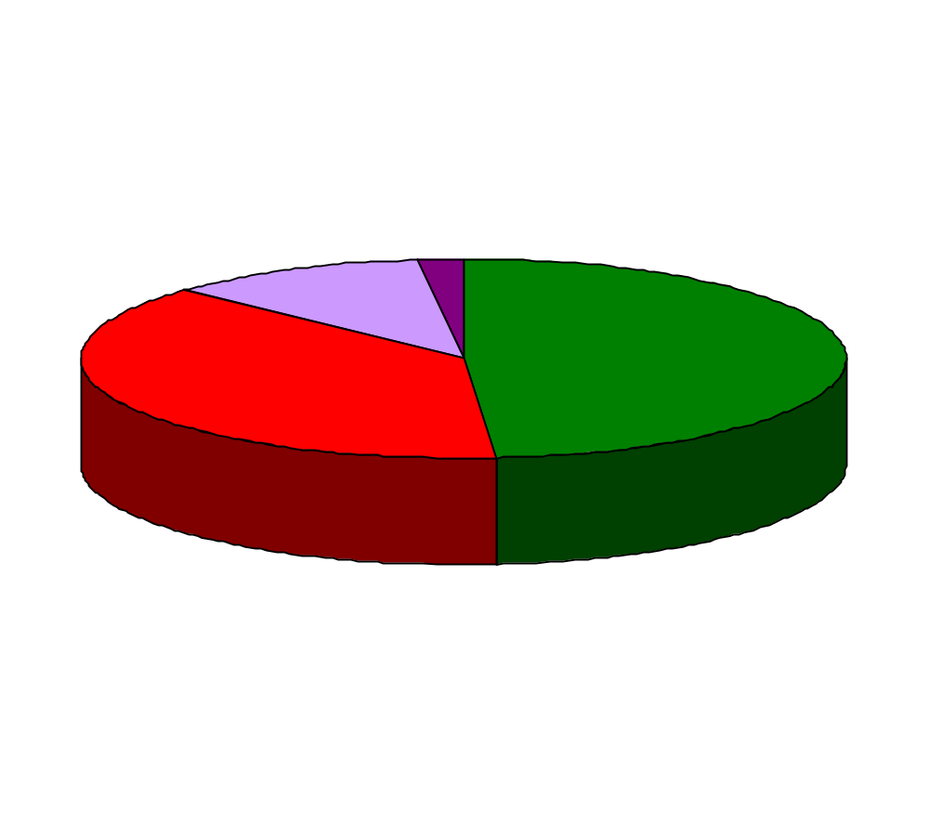
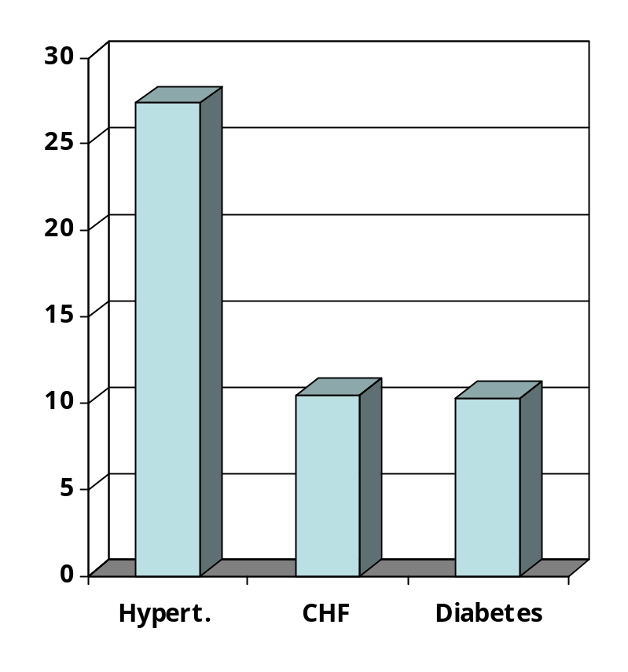
Co-morbidity
>2
2
No
Screening/selection/entry
Prevalence (%)
1
Number of co-morbidities
Co-morbidity
CHF – Chronic heart failure
Crisafulli Thorax 2008

Slide 37
Pulmonary Rehabilitation
Yes
Indication
No
Advise
Healthy life style
Assessment
Intervention
Exercise limitation
Skeletal muscle force
Respiratory muscle force
Format exercise training Define intensity
Exacerbations ?
Self management ?
Need for enhancing
Self management strategies
Nutritional status
Need for nutritional interventions
Psychological morbidity
Need for Psychological counseling
Need for daily life adaptation
Occupational therapy
Social support
Provide Social support
Co-morbidity
Include other disciplines

Slide 38

Algorithm for PR
Initial assessment
Clinical Evaluation, PFT, Dyspnea scores,
6 Minute Walk Test, QoL assessment
Prescribing PR
Psychological intervention
Nutritional intervention
Exercise training
Lower limb
Upper Limb
Combined upper and
lower limb training
Physical training
Breath retraining
Chest PT
Outcome assessment
Quality of Life
Dyspnea parameters
Functional parameters

Slide 39
Medical History and Physical Examination
Respiratory History
Medical history e.g. NMD/ Orthopedic
Active medical problems
Co-morbidities : Osteoporosis / CAD
Use of medical resources
Surgical/Medication history
Smoking / environmental / Recreational history
Alcohol / drug abuse
History of infections
Vaccination
Physical Examination
  Vital Signs
  Finger clubbing
  Simple walk into office
  Extremities : upper & lower
Breathing pattern
Accessory muscle use
Pulse oximetry
Chest examination
Cardiac examination
NMD – Neuromuscular disease
CAD – Coronary artery disease
Notes:
Complete medical history and physical examination which includes respiratory histories, medical histories e.g. NMD, orthopedic history also current medical problems, co-morbidities, use of medical resources and surgical and medication history to be accurately elicited and noted. Routine physical examination with focus on respiratory assessment is important. Observation of Simple walk in office, pulse oxymetry, breathing pattern are essential to determine eligibility for PR.

Slide 40
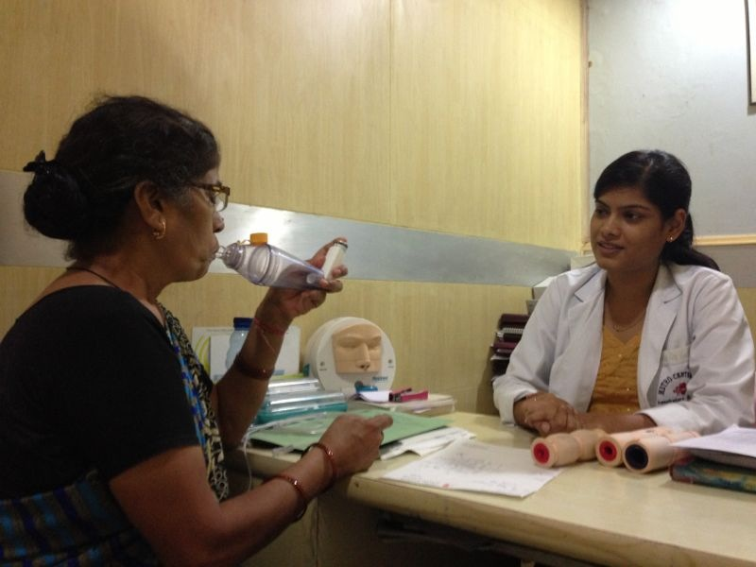
Education assessment
Knowledge about disease & management
Hearing, vision & cognitive ability
Language
Cultural diversity : Attitude towards exercise
Literacy Level

Slide 41
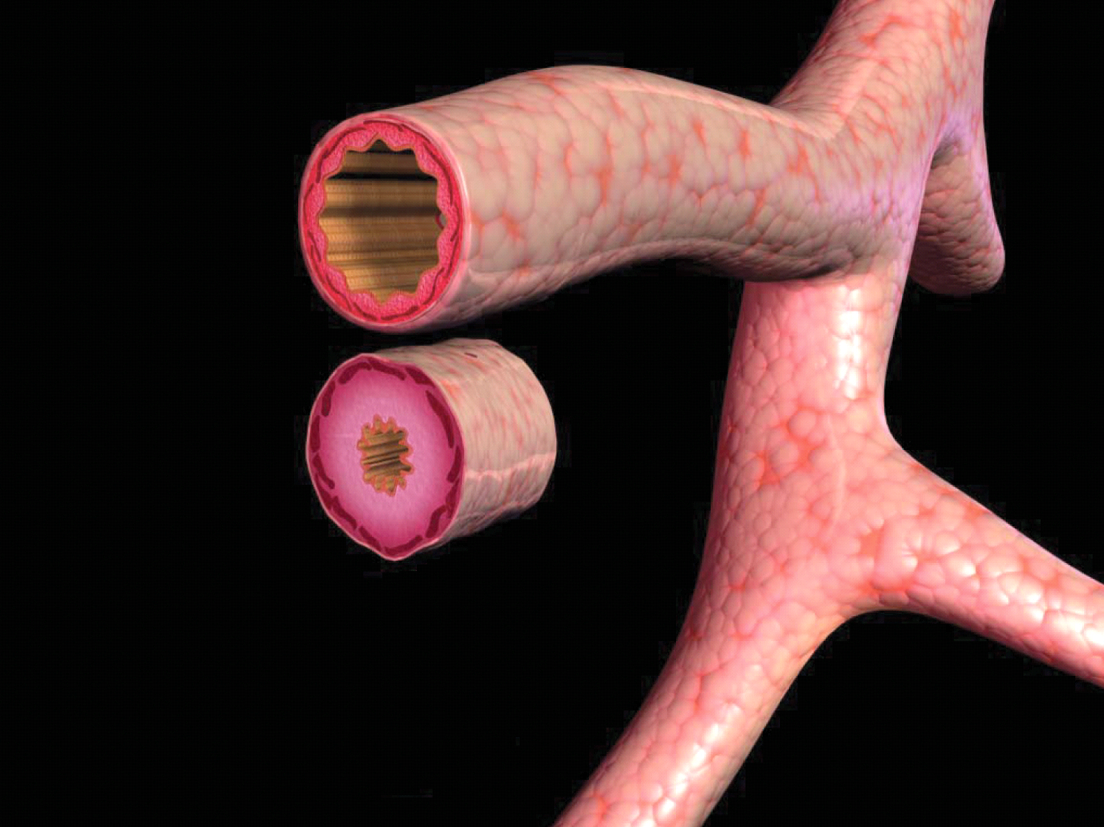
COPD
Normal
Damage +
Cholinergic tone

Slide 42
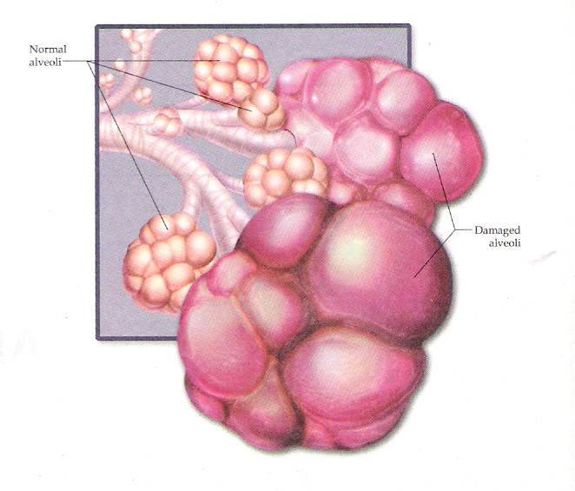
Normal alveoli
Damaged alveoli

Slide 43
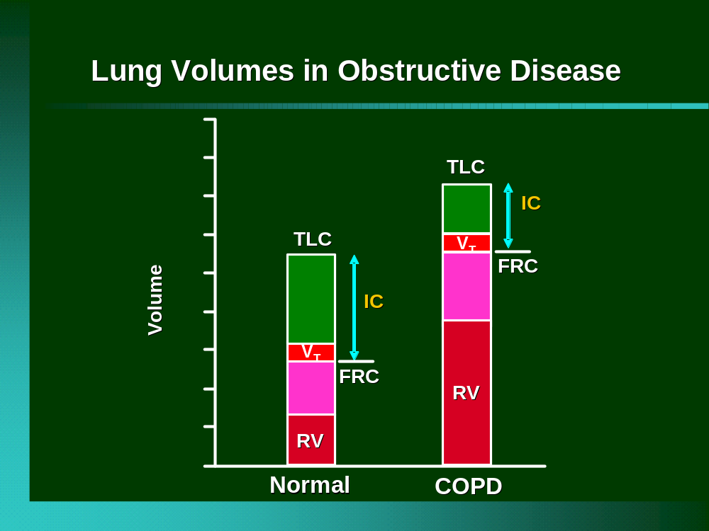
Notes:
This slide shows a graphic representation of hyperinflation and gas trapping in COPD compared to normal lung function.
In the COPD graphic, there is an increase in RV (residual volume) and FRC (functional residual capacity), which leads to a decrease in IC (inspiratory capacity).
Of all lung volumes, IC has the highest correlation with dyspnea.
During activity it is optimal to improve minute ventilation by increasing tidal volume (VT) rather than by increasing respiratory rate. However, as can be seen by the reduction in IC, there is less room to expand tidal volume in patients with COPD and hyperinflation.

Slide 44
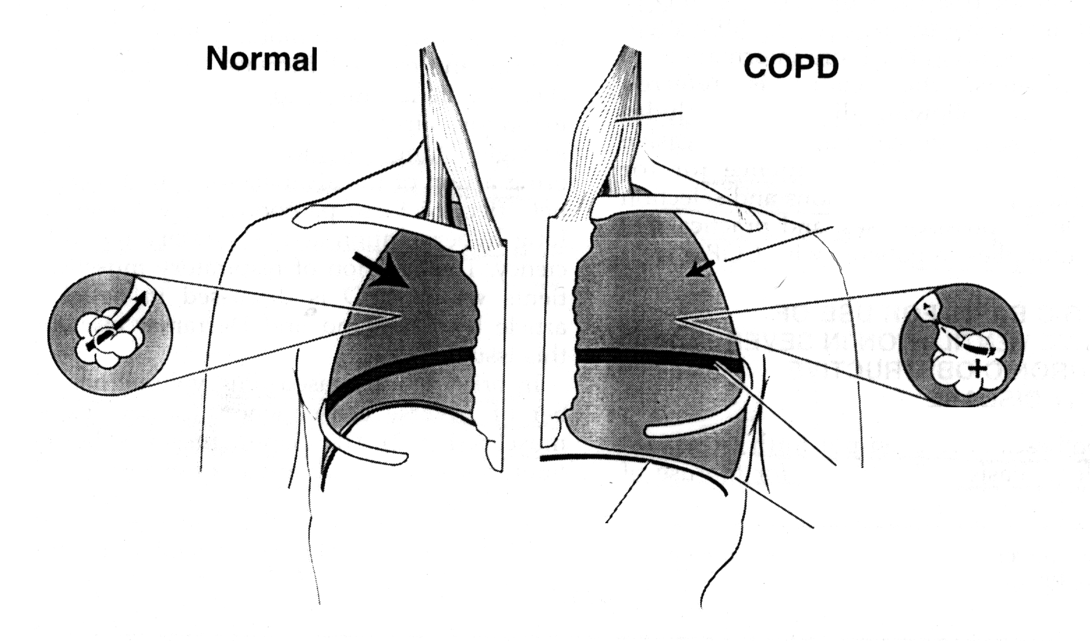
Ventilatory Dysfunction in COPD
Accessory
Muscles
Reduced lung &
chest Wall recoil
Auto PEEP
Horizontal Ribs
Flattened
diaphragm
Decreased Zone of Apposition

Slide 45
Causes of Dyspnea in COPD
narrowed airways (bronchospasm, increased compliance
airway secretions, airway thickening, increased cholinergic tone)
hyperinflation
breathing at
high volumes
diaphragm
flattening
DYSPNEA

Slide 46
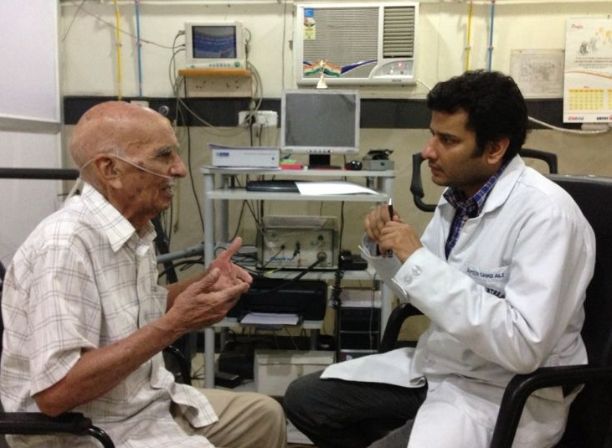
Psychosocial Assessment
Perception of QOL & ability to adjust to disease
Anxiety & depression
Neuropsychological
impairment
Motivation for PR by team & pulmonologist

Slide 47

Motivation

Slide 48
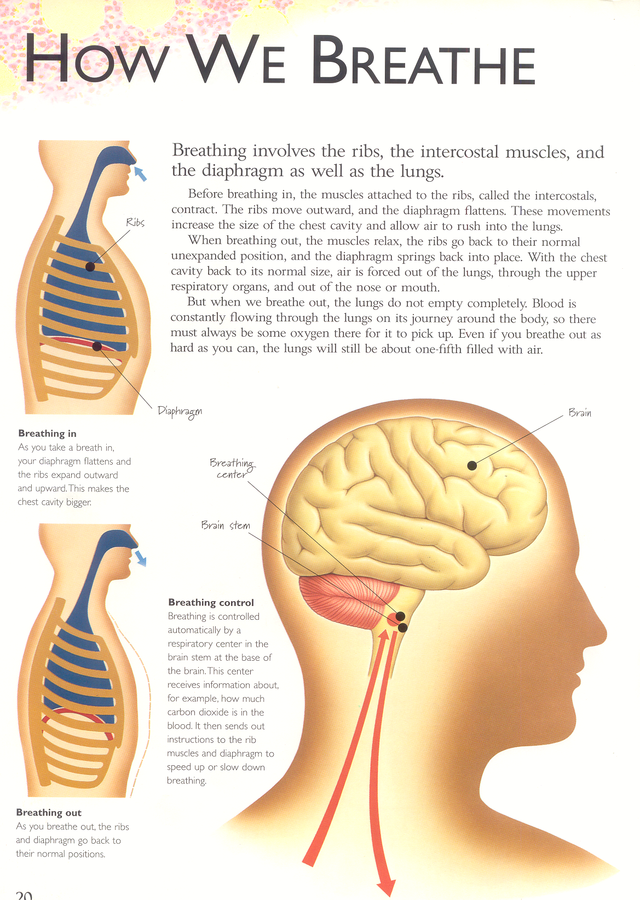

Slide 49

Getting firm
Shaping & toning

Slide 50
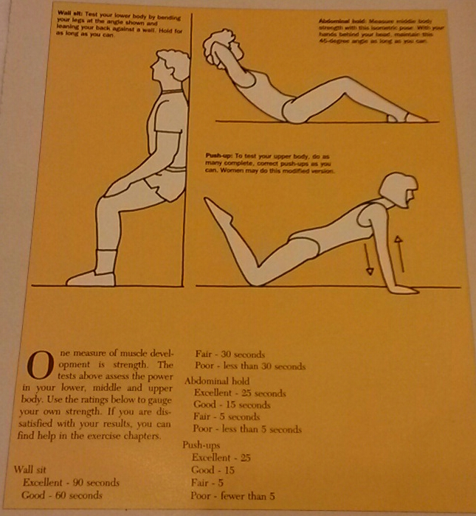
Test your strength

Slide 51
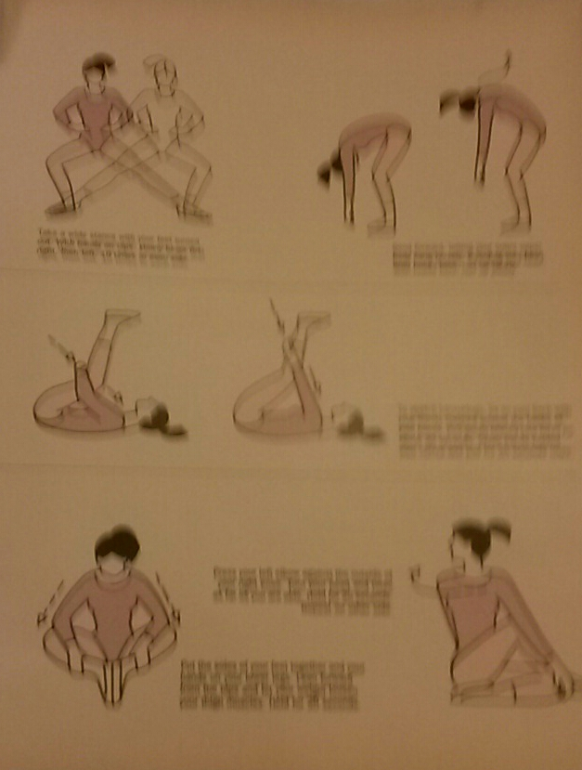
Warm ups

Slide 52
Ten guidelines for workout
Warm up
Work larger muscles first
Pair your exercises
Use variations carefully
Work slowly and steadily
Breathe evenly
Use a full range of motion
Rest between sets
Cool down
Keep track of your progress

Slide 53
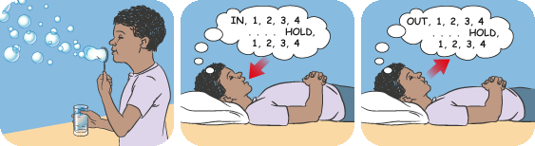
BREATHING & RELAXATION

Slide 54

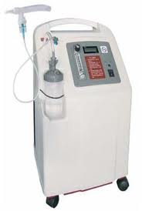
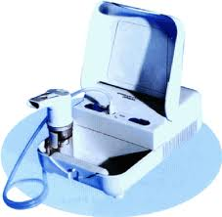
Device education

Slide 55
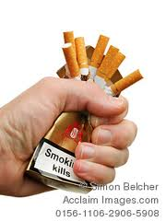
Quit Smoking

Slide 56
Smoking cessation
Ask | Identify all tobacco users at every visit
Advise | Strongly urge all tobacco users to quit
Assess | Determine willingness to make a quit attempt
Assist | Help the patient with a quit plan, provide practical counselling, treatment and social support, recommend the use of approved pharmacotherapy
Arrange | Schedule follow-up contact

Slide 57
Cognitive behavioural therapy (CBT)
Evidence-based psychological treatment focusing on thoughts, beliefs and attitudes, how these impact on behaviour and dealing with problems and whether there are alternative ways.
Pre-pulmonary rehabilitation interventions using cognitive behavioural techniques may improve completion of pulmonary rehabilitation.
Bolton CE, et al. Thorax 2013;68:ii1–ii30. doi:10.1136/thoraxjnl-2013-203808

Slide 58
Breathing techniques
Pursed Lip Breathing
Segmental breathing exercises
Thoracic expansion exercises
Autogenic drainage
Postural drainage
Notes:
PLB - explain physiological mechanism, and more in demo, segmental and thoracic expansion exercises explain in demo, Autogenic drainage-
technique mostly used to remove secretion in sitting posture, explain physiology of technique , works on the principle of low lung volume, mid lung vol, high lung volume expiratory breathing end with huffing.
Postural drainage works on the principle of gravity, so more explanation in demonstration.

Slide 59
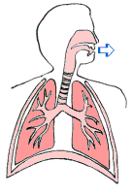

More breath per breath

Slide 60
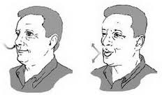
Pursed lip breathing

Slide 61



Energy conserving

Slide 62
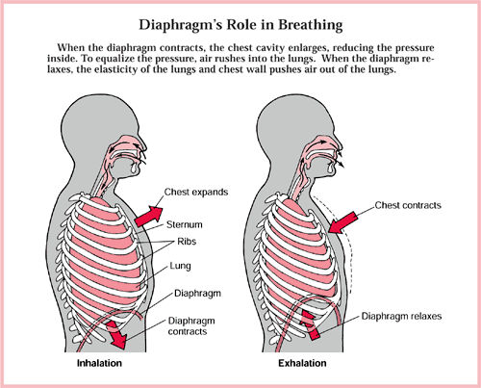
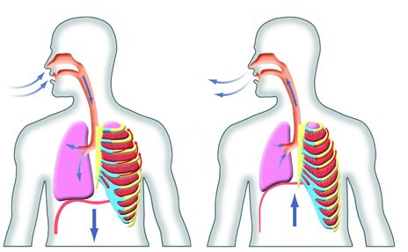
Diaphragmatic breathing

Slide 63
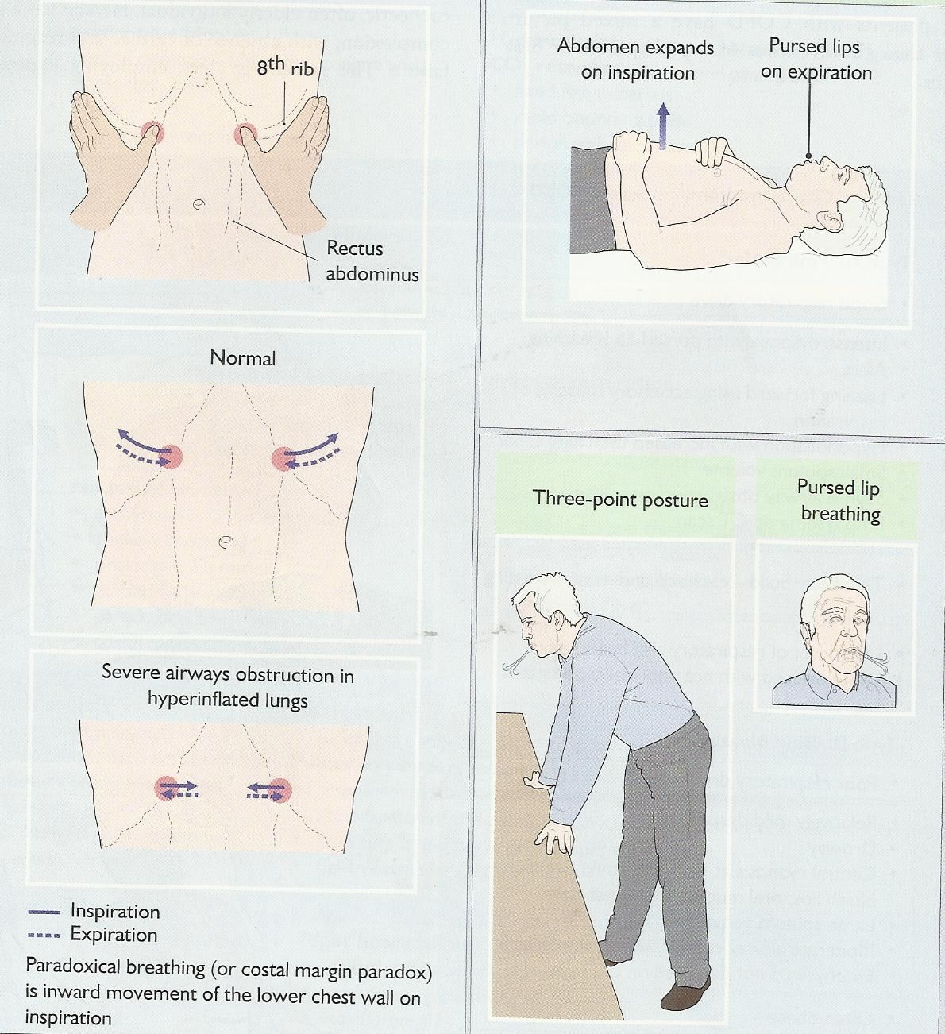
Diaphragmatic Breathing

Slide 64


Slide 65
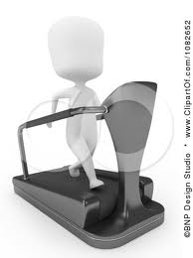
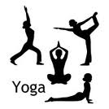

Muscle Reconditioning

Slide 66
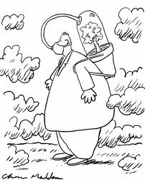
Oximetry and Six-minute walk test

Slide 67
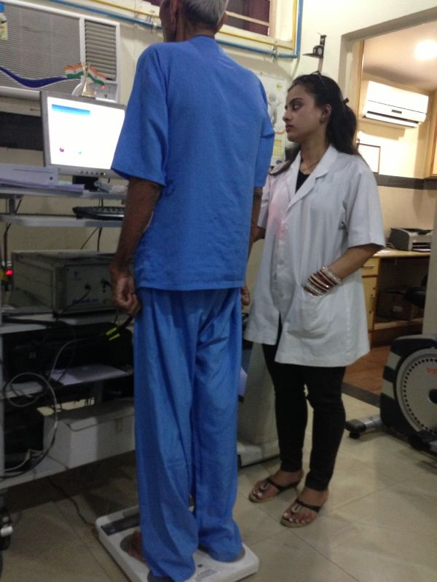
Nutrition Assessment
Height & Weight
BMI
Dietary History
Fluid intake / Exercise losses
Lean body mass determination
S Albumin / pre albumin
Alcohol
Weight change
Malnutrition needs to be identified at the beginning
Notes:
To be only touched upon in this section, covered in detail by the nutritionist in respective section.

Slide 68
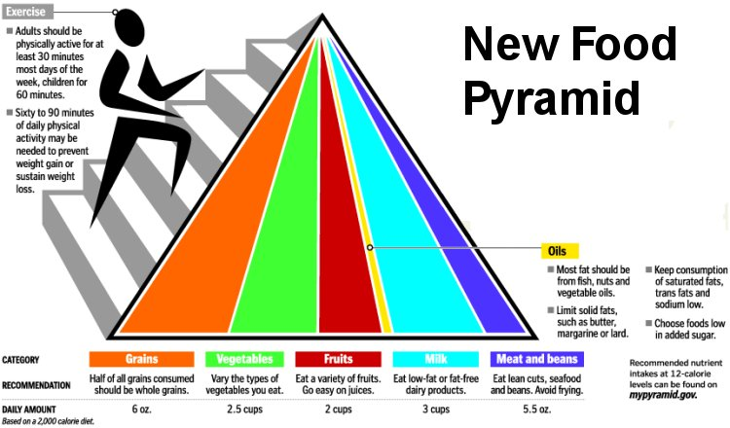
Nutrition

Slide 69
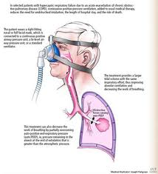
Non-invasive ventilation

Slide 70
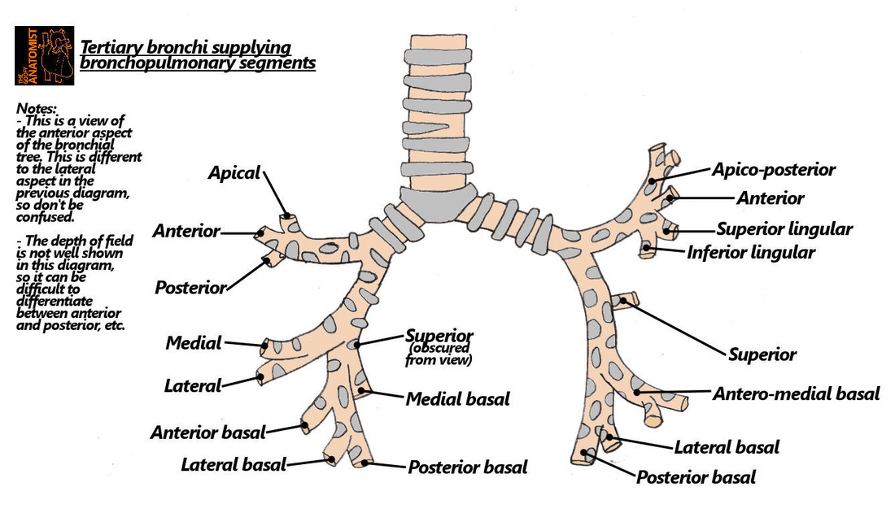

Slide 71
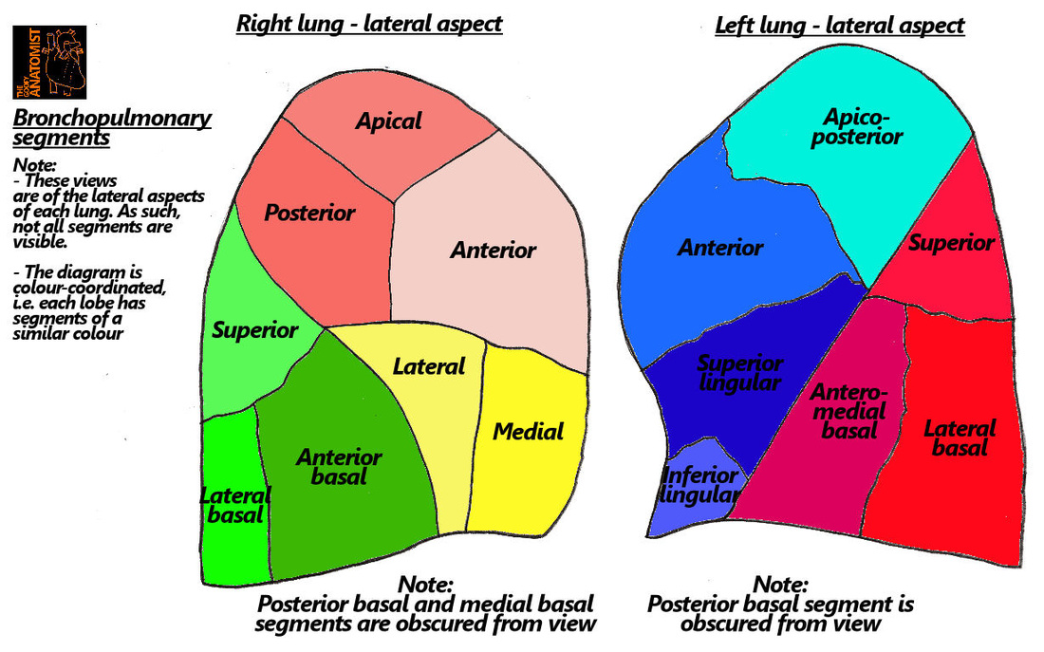

Slide 72
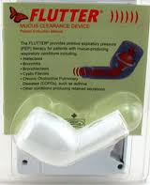
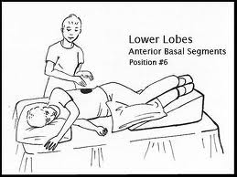
Mucus clearing and postural drainage

Slide 73
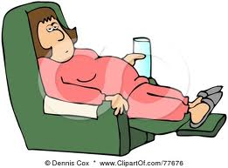
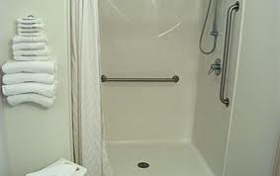

Lifestyle modification

Slide 74
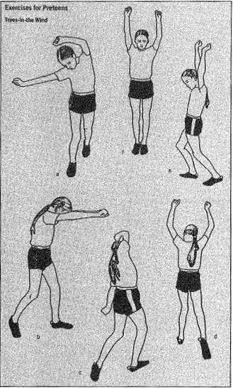
BACK STRETCHES

Slide 75
Sample Program
2 to 3
times
per week
Motivation & Six mt walk test
Breathing exercises Om, Spirometry , IMT, PEEP
Mucus clearance
Steam, Postural drainage ,Cough Assist Device
Education
Disease, Devices, Oxygen, NIV
Nutrition Assessment
Aerobics Yoga, cycling, treadmill

Slide 76
ATS/ERS guidelines
Practice guidelines
A minimum of 20 sessions, 3 x week, 2 supervised
High intensity produces greater physiological benefit
Interval training may be useful
Upper and lower limb extremity training
Combination of endurance and strength generally has multiple beneficial effects and is well tolerated
Endurance training should exceed 60% of maximal work rate
Total effective training time should ideally exceed 30 minutes
Strength training 2-4 sets , 6-12 repetitions, 50-85% 1RM
Am J Respir Crit Care Med 173;1390-1413.2006

Slide 77
Duration 0f PR program
How long should an out-patient course of rehabilitation be?
What are the current recommendations?
No consensus on optimal duration
For individual patient is ideally set by continued progress toward goals and optimization of benefit
Minimum of 8 weeks recommended to achieve a substantial effect
Longer programs are thought to produce greater gains and maintenance of benefits
Spruit MA et al. Am J Respir Crit Care Med 2013 Oct 15;188(8):e13–e64.

Slide 78
Continued…
The number of sessions per week varies
  Outpatient programs - 2 or 3 days/week
  Inpatient programs - 5 days/week
Session length per day - generally 1–4 hours
Which is usually within the attention span and physical capability of a patient with chronic respiratory disease
Spruit MA et al. Am J Respir Crit Care Med 2013 Oct 15;188(8):e13–e64.

Slide 79
4 vs 7 week course of rehabilitation
N=100
4 weeks of rehabilitation vs 7 weeks
Assessments at baseline, 7 weeks for all plus 4 week assessment for 4 week group
Sewell L et al Thorax 2006

Slide 80
Field test of exercise capacity
(6 Minute Walk Test)
ATS’s Standard

Slide 81
Six minute walk
Objective & Principle:
  Alternative method of assessing functional capacity; correlated to ADL
  Measures distance covered during 6 minutes of self-paced walking
Evaluation parameters
  Percentage of predicted 6-min walk distance
  miles per hour walked
  METS
  THR
Uses
  Pre-treatment/post-treatment comparisons
  Functional status
  Predict morbidity & mortality
METS – Metabolic Equivalents
THR – Training Heart rate
Am J Respir Crit Care Med 2002;166:111–117

Slide 82
Six minute walk
Required Equipment
  Countdown timer (or stopwatch)
  Mechanical lap counter
  Two small cones to mark the turnaround points
  chair that can be easily moved along the walking course
  Worksheets on a clipboard
  source of oxygen
  Sphygmomanometer
  Telephone
Facility needs
  Ideally 100-foot hallway or space to accommodate 30-meter (15 m/50 feet acceptable) walkway
  No advanced training for technicians required
  This test measures the distance that a patient can quickly walk on a flat, hard surface in a period of 6 minutes (the 6MWD).
HR –Heart Rate
SpO2 - Pulse Oximeter Oxygen Saturation
RPE - Rating of Perceived Exertion
Am J Respir Crit Care Med 2002;166(1):111–117

Slide 83
Six minute walk
Recommended standardized script to be used at start of and during assessment
Instruct patient to cover as much ground as possible in the given time
Coach and give encouragement
  Standard phases of encouragement
  “You are doing well you have 5 minutes to go”
  “You are doing well you have 4 minutes to go”
  “You are doing well you are half way done etc”.
Local words of encouragement are not recommended
Am J Respir Crit Care Med 2002;166(1):111–117

Slide 84
Six minute walk
Parameters recorded
  Seated, resting HR, SpO2,BP
  Standing rating of dyspnea & RPE
  Post-test SpO2 and HR, RPE, rating of dyspnea
  Number of laps completed and additional distance completed in meters in a final partial lap; calculate total distance walked
Am J Respir Crit Care Med 2002;166(1):111–117

Slide 85
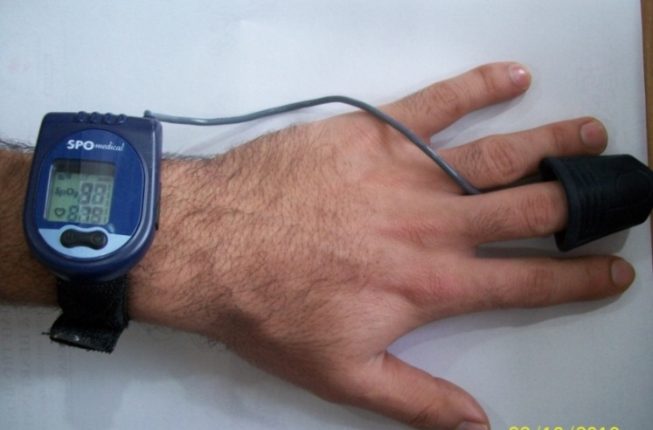
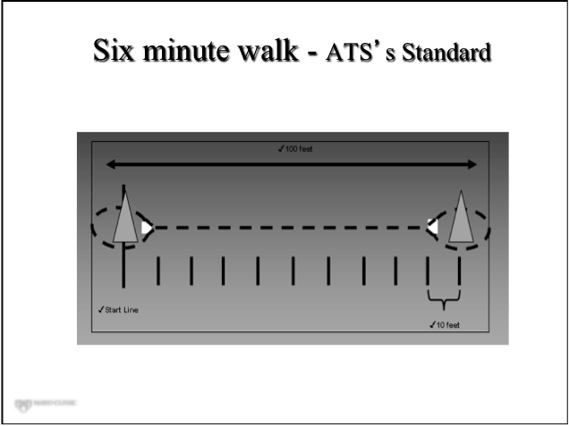
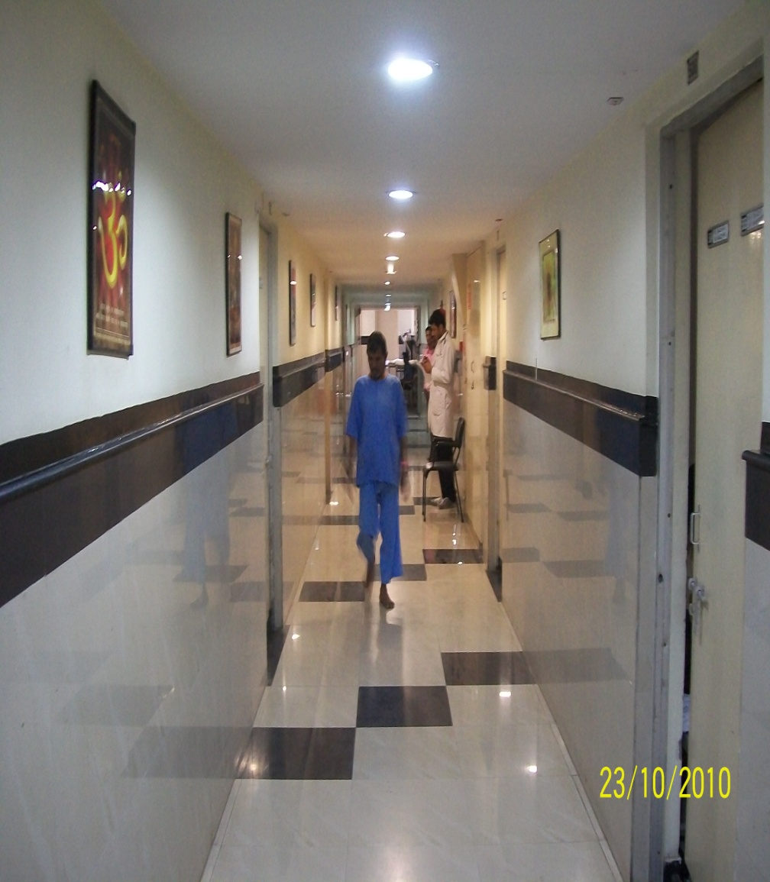
Six minute walk
Am J Respir Crit Care Med 2002;166:111–117

Slide 86
Interpretation of results
Primary measurement
  total distance walked
Secondary measurement
  Fatigue and dyspnea, measured with a modified Borg or VAS.
  Arterial oxygen saturation measured with pulse oximetry (oximeter should be portable and not heavy)
Calculating predicted distance using equations from a published study of healthy people of the same age group
  Men = (7.57*ht) – (5.02*age) – 1.76*wt -309m
  Women = (2.11*ht) – (2.29*wt) – (5.78*age) + 667m
Reference equations for healthy Indian individuals (30-80 years)
  Indian males
  561.022−(2.507×age [years])+(1.505×weight[kg])−(0.055 ×height [cm])
  Indian females
  30.425−(0.809×age[years]) −(2.074×weight[kg])+(4.235×height [cm])
Lung India 2014;31 (1)
Am J Respir Crit Care Med 1997;155(4):1278–1282.

Slide 87
Interpretation
Healthy subjects’ 6MWDs range from 400 to700m.
Study showed that an improvement of > 70 m walked was clinically important to patients.
Minimal clinically important difference(MCID) for the 6MWT is conservatively estimated to be 54-80 m (~175-260 ft) using both distributional and discriminative methods.
For an individual patient, the 6MWT would need to change by about 86 m (280 ft) to be statistically confident that there has been a change.

Slide 88
Six minute walk
Contraindications
Absolute
  Unstable coronary disease
  Myocardial infarction within a month
• Relative
  Resting tachycardia > 120 beats/min
  Systolic BP > 180 mmHg
  Diastolic BP > 100 mmHg
  Systolic BP < 80 mmHg
  Diastolic BP <50 mmHg( asymptomatic or as directed by referring physician for 6MWT)
  Syncope with exercise
  Resting oxygen (O2) saturation level < 80% while breathing O2 or room air
Hodgkin JE. Pulmonary Rehabilitation Guidelines to Success , 4th edition. MosbyElsevier,2009pp154-179

Slide 89
Six minute walk – ATS’s Standard
Advantages
Disadvantages
Easy to administer
Better tolerated
Reflects activities of daily living than other walk tests
Evaluates global and integrated responses of all the systems involved during exercise, including pulmonary and cardiovascular systems, systemic circulation, peripheral circulation, blood, neuromuscular units and muscle metabolism.
Self-paced and a patient is probably less likely to push himself beyond his endurance or through angina or other pain than during the other walk test.
Allowed to stop and rest during the test
It does not provide specific information on the function of each of the different organs and systems involved in exercise or the mechanism of exercise limitation, as is possible with maximal(CPET).
6MWT does not determine peak oxygen uptake, diagnose the cause of dyspnea on exertion, or evaluate the causes or mechanisms of exercise limitation.

Slide 90
Six minute walk – ATS’s Standard
Reasons to terminate test before 6 minutes
  – Chest pain
  – Intolerable dyspnea (i.e. Borg Scale Score>7)
  – Leg cramps
  – Staggering (ataxia)
  – Diaphoresis
  – Pale or ashen appearance
Safety issues
  Performed in a location where a rapid, appropriate response to an emergency is possible – crash cart, medications, phone
  Trained medical staff with BLS, although ACLS preferred
  If a patient is on oxygen use their standard rate or as directed.

Slide 91
Cardiopulmonary Exercise Test
Can evaluate contribution of respiratory, cardiovascular, and peripheral tissue function in support of maximal exercise.
Used to evaluate the level of exercise intolerance in patients with lung and heart diseases
More complex than other functional exercise testing
Greater equipment requirement, often complex interpretation strategies required
Not widely available in all settings of clinical practice.
Pichurko BM. Respir Care 2012;57(1):100 –110.

Slide 92
Designing an exercise program
A pulmonary rehabilitation program must include, at minimum, lower limb endurance exercise training.
  Lower limb endurance training
  Home exercise program
Optimally, a pulmonary rehabilitation should also include:
  Upper limb endurance training
  Lower limb strength training
  Upper limb strength training
Other components that may be included are:
  Flexibility and stretching exercises
  Balance exercises
  Inspiratory Muscle training

Slide 93
Stretching Exercises for flexibility

Slide 94
Strength Training - Lower Limb
Skeletal muscle weakness is present in patients with COPD and this weakness can affect lower limb strength
Strength training can improve
  muscle strength,
  peak work capacity and
  endurance time.

Slide 95
Strength training with weights:
  Leg press
  Quadriceps extension
Strength training without weights:
  Squats
  Straight leg raise
  Step-ups or stair climbing
  Sit-to-stand from progressively lower chairs

Slide 96



Lower Limb Strength Exercises
(high weight and low repetition)
Notes:
For lower limb strength- in assessment remove 10 RM of big muscles like quads, hamps, abductors, where patient should be able to perform action with maximum weight 10repitation.
Start training 60-80% of 10RM weight they can carry. and start training with that weight. 1 set=10-12 repetition, progress no of sets till 3.
Again check 10RM and increase weight in progression.

Slide 97
Strength Training- Upper Limb
Upper limb muscle strengthening is important as these muscles are used for everyday work.
Upper limb strength training results in moderate improvements in upper limb strength (o shea 2004)
A relationship has been shown between upper limb strength and upper limb work capacity for patients with COPD
Stronger upper limb muscles may help patients perform functional tasks (i.e. by enhancing the strength of the biceps and triceps muscles).
Notes:
Studies indicate that strength training for upper limb muscles results in moderate improvements in upper limb strength (o shea 2004)

Slide 98
Continued…
Strength training with weights and weight machines:
  Hand weights for biceps and triceps
  Lat/chest pull down for latissimus dorsi
  Chest press for pectorals
Strength training without weights machine
  Wall push-ups for pectorals
  Theraband resistance for pectorals and latissimus dorsi

Slide 99



Upper Limb Strength Exercises
(high weight and low repetition)
Notes:
Upper limb strength assessment- remove 10RM of big important muscles, like biceps, triceps, shoulder abductor, flexors.
Start training with 60-80% of 10 RM weight , 1 set-10-12 repetition, increase no. of sets up to 3 and Progress training with increasing weight after reassessment of 10RM of specific muscles.

Slide 100




3. Flexibility and Stretching
Notes:
Flexibility and stretching exercises can be included in warm up or cool down exercise set, exercise emphasizing on pectoral muscle or shoulder girdle muscle stretch and exercises concentrating on trunk mobility.,
shown in pictures, also concentrate on lower limb muscle flexibility and stretching which can help them in locomotion and endurance training.

Slide 101


Slide 102


Slide 103

Mobile Home Care Rehab Van

Slide 104
1. Endurance Training

Slide 105
Endurance Training - Lower Limb
Objective :
  To improve the functional exercise tolerance (FET)
  To improve Rate of Perceived Exertion (RPE).
Principle :
Physiological changes:
1. Improved ventilatory muscle function
2. Improved oxidative capacity & efficiency of skeletal
muscle performance
Less alveolar ventilation for given work rate
Reduce dynamic hyperinflation, Exertional dyspnea
Improving FET

Slide 106
Exercise training
Dynamic hyperinflation
RR, Minute ventilation
Lactic acid production for given work rate
Improvement in
6MWTD – 6 Minute Walk Test Distance
RPE - Rating of Perceived Exertion

Slide 107
Benefits
Capillary contacts proportional to in fiber cross sectional area
Capacity of oxidative enzyme
Improved aerobic capacity
Improved skeletal muscle performance and techniques of performance
Desensitization to sensation of dyspnea
Increased Motivation

Slide 108
Continued…
Mode:
Lower limb aerobic exercises (uses large muscle mass)
Walking training for all patients
Stationary cycling training if possible
Intensity:80% of the average 6MWT speed
To calculate an appropriate intensity for walking laps: 80% ([6MWD ÷ 6] x prescribed duration)
or 75% of the peak speed achieved on the ISWT

Slide 109
Endurance Training - Upper Limb
Mode:
Consider following points when prescribing unsupported arm exercises with aim of increasing endurance exercise capacity:
A weight should be chosen that patient can only lift 15 times.
Each exercise should be repeated 15 times followed by rest.

Slide 110


Low weight and high repetition
Notes:
Endurance training for upper limb-
start with minimal weight in form of dumbell or weight cuff e.g. 250 grams, 1 set= 10rep, increase no. of sets

Slide 111
4. Warm-up and Cool-down
Warm-up and cool-down exercises can be included in exercise training sessions.
Flexibility, stretching and balance exercises can be included as part of the warm-up and cool-down section of each exercise session.

Slide 112


5. Breathing exercises
Notes:
Ballon bladder for expiratory exercise, 10 rep twice in a day, and incentive spirometer start with minimal 200cc, correct technique is very important, teach them properly, and tell how to progress, after holding ball up for 3sec then only progress to next level.

Slide 113

Chest Percussion

Slide 114

Lingula

Slide 115

Middle Lobe

Slide 116

Lower Lobes

Slide 117

Lower Lobes

Slide 118

Lower lobes

Slide 119
Lower Lobes

Slide 120
SESSIONS
INTRODUCTION & MOTIVATION
WELLNESS ASSESSMENT
SET GOALS & FITNESS PROTOCOLS
NUTRITION
ACTIVITY ,ADL, ERGONOMICS
ENDURACE ASSESMENT
LIFESTYLE MODIFICATION
BREATHE MORE
SPECIFIC AREAS
SUPPLEMENTS
SOCIAL SUPPORT

Slide 121
Cardiac Rehab

Slide 122


Slide 123
Core Program Components
Risk factor management
Baseline & ongoing patient assessment
Exercise/activity training
Notes:
The core components identified by the AHA/AACVPR Scientific Statement are not intended "...to promote a rote approach or homogeneity among programs, but rather to foster a foundation of services upon which each program can establish its own specific strengths and identity and effectively attain outcome goals for its target population."
Balady, G. et al. Core components of cardiac rehabilitation/secondary prevention programs: A statement for healthcare professionals from the American Heart Association and the American Association of Cardiovascular and Pulmonary Rehabilitation. Circulation, 2000; 102:1069-1073.

Slide 124
Exercise Research
Direct relation between inactivity and cardiovascular mortality. Inactivity is an independent risk factor for of CAD.
Exercise capacity is a more powerful predictor of mortality among men than other established risk factors for CAD.
Physical fitness has been clearly associated with improvements in lipid profiles.
Notes:
Recent research has confirmed the importance of exercise/activity on coronary artery disease.
Articles published in Circulation, New England Journal of Medicine and the American Journal of Cardiology identify that physical inactivity is an independent risk factor for CAD and that exercise capacity is a powerful predictor for the development and progression of CAD.
Circulation 1996; 94: 857-62
Myers et al, NEJM, 2002; 346: #11, 793-801
Improved levels of physical fitness has been shown to decrease established risk factors such as hyperlidemia.
Although exercise is the cornerstone of cardiac rehabilitation, it is not just an exercise program at the local “gym”. It is a monitored (telemetry, hemodynamics, etc) supervised progressive activity program tailored to meet the needs of each patient. The program consists of stretching/ROM exercises, aerobic exercise and even resistive exercises (light weight training).
Lavie CJ and Milani RV. AJC 1996; 78: 1286-1289
Brubaker PH et al. AJC 1996; 78: 769-773

Slide 125
            Body Mass Index (BMI)
  Normal weight = 18.5-24.9
  Overweight = 25-29.9
  Obesity = BMI of 30 or greater
Notes:
Body Mass Index is defined as weight in kilos divided by height, squared..so it looks like this: kg/m2
Body mass index (BMI) is measure of body fat based on height and weight that applies to both adult men and women.
BMI Categories:
Normal weight = 18.5-24.9
Overweight = 25-29.9
Obesity = BMI of 30 or greater
Reference: US Department of Health and Human Services, retrieved from: http://www.nhlbisupport.com/bmi/bminojs.htm
The information you need is someone's weight in kilograms and then their height. The formula is:
Metric BMI Formula BMI = ( Weight in Kilograms / ( Height in Meters ) x ( Height in Meters ) )
For example: BMI = (75 kg/ 1.6 m) x (1.6 m) = 75/2.56 =29.29 BMI, which then rounds up to 29.3…This BMI indicates this person is overweight…not quite obese, but getting close!
Exercise: Calculate your own BMI, where are you on the BMI scale?

Slide 126
Cause of Obesity
Simple equation…when you eat more than you use..it is stored in your body as “fat”.
  Causes:
    Processed food
    Higher sugar, fat and calories in what we eat
    Less nutrients
    Reduced intake of vitamins and minerals
Notes:
This in itself is alarming…we are getting more and more overweight with most occurring in urban settings. As income rises, food intake increases. There is also a global shift in how we eat. More salt, more fat and more sugars. The more we process food, the more we change the food we eat, the less nutrient dense it is. There is a decrease in vitamins, minerals and micronutrients that help our bodies to stay healthy (WHO, Fact Sheet 311). The other issue is we exercise less than we used to. When life has many tools that can make our lives easier…we move our bodies less, we sit more, well, we do not burn calories. An increase of video games, electronics have caused kids to play less and eat more. The challenge is getting kids to get outside and play at least one hour a day.

Slide 127
What does obesity do to our bodies?
  Cardiovascular disease
  Diabetes type 2
  Musculoskeletal disorders
  Cancers-endometrial, cervical and colon
  Infertility
  Gallstones
  Premature death and disability
Notes:
We know what obesity can do to our bodies..but what is interesting is that obesity is preventable. In the last slide, the information that obesity is caused by eating more than our bodies need…so if we eat the right amount of food…we will be healthier and have much less chance of being obese…seems to simple doesn’t it? The challenge is, when we have so many choices and eat the Western diet, we have a strong tendency to eat more than we need.
Exercise: Is there anyone in your family that has health problems with obesity or being overweight? When did they start being overweight? Are they healthy? Do you have anyone in your family with diseases related to obesity?
What are your favorite foods? Are they processed and have lots of sugar and fat? Many people will say they like desserts, candy or soda pop…all can cause someone to gain weight.
Reference: World Health Organization.(2008). Obesity and overweight. Fact sheet #311. Retrieved from http://www.who.int/mediacentre/factsheets/fs311/en

Slide 128
Nutrition
Nutrition counts!
  Nutrition is everything! Healthy foods, fruits, vegetables, legumes…a colorful diet is best!
  Low sugar, low fat
  Work out
Notes:
General recommendations:
Generally speaking, this lecture has been about healthy eating, exercise and the implications of what can happen if a person does not…but the question that needs to be asked is so…how much is enough…what kind of nutrition is correct? Although this lecture will not discuss nutrition in depth, there is some basic information that can be helpful. According to World Health Organization (2010), children need to have a varied diet, the more colorful the better….however, children need to simply eat more fruits and vegetables, fresh is best. Canned has too much sugar and salt. Lean proteins such as chicken and fish. Beef, veal and lamb are very high in fat. When having breads, whole grain is best. With rice, brown rice is preferred. The key is to have as much fresh, wholesome food as possible for children, and adults.
Children also need to play outside, or inside if outside is not a good choice, but play with moderate activity at least one hour a day. Playing soccer, swimming, walking, running, playing basketball…anything that helps children to move their bodies.
Reference: WHO Childhood Obesity, from http://www.who.int/dietphysicalactivity/childhood_what_can_be_done/en/print.html

Slide 129
Fruits and Vegetables
WHO states:
  Fruits and vegetables need to be part of the daily diet to prevent disease such as obesity and non communicable disease
  The statistics are startling
    Lack of enough fruits and vegetables cause
      19% of GI deaths
      31% of Ischemic heart disease
      11% of stroke
Notes:
Reference:
World Health Organization. (2004) Promoting fruit and vegetable consumption around the world. Retrieved from http://www.who.int/dietphysicalactivity/fruit/en/index.html

Slide 130
How much fruit is enough?
WHO recommends at least 400 gms of fruit and vegetables each day…
  This will prevent chronic disease related to overweight and obesity
    Heart disease
    Diabetes
    Cancers
Notes:
Keep in mind, that even with more fruits and vegetables in the diet, there is still need to reduce the fats, sugars and processed foods. Keep in mind that tubers, such as potatoes and cassava are not included in fruits and vegetables.
Reference:
World Health Organization. (2004) Promoting fruit and vegetable consumption around the world. Retrieved from http://www.who.int/dietphysicalactivity/fruit/en/index.html

Slide 131

Physical Activity
Primary Effects on Osteoporosis
Many studies have been conducted.
According to findings, routine physical activity, especially weight-bearing and impact exercise, prevents bone loss associated with aging.
.
Notes:
Several longitudinal studies have examined the effects of exercise training on bone health in children, adolescents and young, middle-aged, and older adults.
Although the numbers of studies and total participants are small when compared to studies found in the cardiovascular literature, the results are rather compelling and they indicate that routine physical activity, especially weight-bearing and impact exercise, prevents bone loss associated with aging.

Slide 132
Eating for Weight Loss

Slide 133

The Critical Role of Healthy Eating
Good nutrition leads to a healthier life
CDC
Notes:
Research shows that good nutrition lowers one’s risk for many chronic diseases, including heart disease, stroke, some types of cancer, diabetes, and osteoporosis.
Although Americans are slowly adopting healthier diets, there still remains a large gap between recommended dietary patterns and what Americans actually eat.

Slide 134

Dietary Guidelines
Tips for Healthy Eating
MyPyramid, which is the newest Food Guide Pyramid, recommends the following for a healthy lifestyle:
Make half your grains whole
Vary your veggies
Focus on fruit
Get your calcium rich foods
Go lean with protein
Find your balance between food and physical activity
Notes:
MyPyramid, which is the newest Food Guide Pyramid, recommends the following for a healthy lifestyle:
Make half your grains whole
Vary your veggies
Focus on fruit
Get your calcium rich foods
Go lean with protein
Find your balance between food and physical activity

Slide 135
A Healthy Diet
Emphasizes fruits, vegetables, whole grains, fat-free or low-fat milk, & milk products;
Includes lean meats, poultry, fish, beans, eggs, and nuts
Is low in saturated fats, trans fats, cholesterol, salt (sodium), and added sugars.
MyPyramid: http://mypyramid.gov/
Notes:
The Dietary Guidelines for Americans (2005) recommends that we eat more whole grains, more fruits and vegetables and less sugar and fat.

Slide 136

Dietary Guidelines
2. Weight Management
  To maintain body weight in a healthy range, balance calories from foods and beverages with calories expended.
  To prevent gradual weight gain over time, make small decreases in food and beverage calories and increase physical activity.
Notes:
Dietary Guidelines for Americans, 2005
Key Recommendations for the General Population
Weight Management
To maintain body weight in a healthy range, balance calories from foods and beverages with calories expended.
To prevent gradual weight gain over time, make small decreases in food and beverage calories and increase physical activity.

Slide 137

Dietary Guidelines
3. Physical activity
  Engage in regular physical activity and reduce sedentary activities to promote health, psychological well-being, and a healthy body weight.
  Achieve physical fitness by including cardiovascular conditioning, stretching exercises for flexibility, and resistance exercises for muscle strength and endurance.
Notes:
Dietary Guidelines for Americans, 2005
Key Recommendations for the General Population
Physical activity
Engage in regular physical activity and reduce sedentary activities to promote health, psychological well-being, and a healthy body weight.
Achieve physical fitness by including cardiovascular conditioning, stretching exercises for flexibility, and resistance exercises for muscle strength and endurance.

Slide 138



Dietary Guidelines
4. Food Groups to Encourage
  Consume a sufficient amount of fruits and vegetables while staying within energy needs.
  Choose a variety of fruits and vegetables each day. Select from all five vegetable subgroups (dark green, orange, legumes, starchy vegetables, and other vegetables) several times a week.
  Consume 3 or more ounce-equivalents of whole-grain products per day, with the rest of the recommended grains coming from enriched or whole-grain products. At least half the grains should come from whole grains.
  Consume 3 cups per day of fat-free or low-fat milk or equivalent milk products.
Notes:
Dietary Guidelines for Americans, 2005
Key Recommendations for the General Population
Food Groups to Encourage
Consume a sufficient amount of fruits and vegetables while staying within energy needs.
Choose a variety of fruits and vegetables each day. Select from all five vegetable subgroups (dark green, orange, legumes, starchy vegetables, and other vegetables) several times a week.
Consume 3 or more ounce-equivalents of whole-grain products per day, with the rest of the recommended grains coming from enriched or whole-grain products. At least half the grains should come from whole grains.
Consume 3 cups per day of fat-free or low-fat milk or equivalent milk products.

Slide 139

Dietary Guidelines for Americans
5. Fats
  Keep total fat intake between 20 - 35 percent of calories (With most fats coming from sources of polyunsaturated and monounsaturated fatty acids, such as fish, nuts, and vegetable oils).
  Limit intake of fats and oils high in saturated and/or trans fatty acids, and choose products low in such fats and oils.
  Consume less than 10 percent of calories from saturated fatty acids
  Consume less than 300 mg/day of cholesterol
  Keep trans fatty acid consumption as low as possible
  When selecting and preparing meat, poultry, dry beans, and milk or milk products, make choices that are lean, low-fat, or fat-free.
Notes:
Dietary Guidelines for Americans, 2005
Key Recommendations for the General Population
Fats
Keep total fat intake between 20 - 35 percent of calories
(With most fats coming from sources of polyunsaturated and monounsaturated fatty acids, such as fish, nuts, and vegetable oils).
Limit intake of fats and oils high in saturated and/or trans fatty acids, and choose products low in such fats and oils.
Consume less than 10 percent of calories from saturated fatty acids
Consume less than 300 mg/day of cholesterol
Keep trans fatty acid consumption as low as possible
When selecting and preparing meat, poultry, dry beans, and milk or milk products, make choices that are lean, low-fat, or fat-free

Slide 140


Dietary Guidelines
6. Carbohydrates
  Choose fiber-rich fruits, vegetables, and whole grains often.
  Choose and prepare foods and beverages with little added sugars or caloric sweeteners.
  Reduce the incidence of dental caries by practicing good oral hygiene and consuming sugar- and starch-containing foods and beverages less frequently.
7. Sodium and Potassium
  Consume less than 2,300 mg (approximately 1 teaspoon of salt) of sodium per day.
  Choose and prepare foods with little salt. At the same time, consume potassium-rich foods, such as fruits and vegetables.
Notes:
Dietary Guidelines for Americans, 2005
Key Recommendations for the General Population
Carbohydrates
Choose fiber-rich fruits, vegetables, and whole grains often.
Choose and prepare foods and beverages with little added sugars or caloric sweeteners.
Reduce the incidence of dental caries by practicing good oral hygiene and consuming sugar- and starch-containing foods and beverages less frequently.
7. Sodium and Potassium
Consume less than 2,300 mg (approximately 1 teaspoon of salt) of sodium per day.
Choose and prepare foods with little salt. At the same time, consume potassium-rich foods, such as fruits and vegetables.

Slide 141

Dietary Guidelines for Americans
8. Alcoholic Beverages
  Those who choose to drink alcoholic beverages should do so sensibly and in moderation (≤ 1 drink for women/day and ≤ 2 drinks for men/day).
  Alcoholic beverages should be avoided by individuals engaging in activities that require attention, skill, or coordination, such as driving or operating machinery.
  Alcoholic beverages should not be consumed by some individuals, including: those who cannot restrict their alcohol intake, women of childbearing age who may become pregnant, pregnant and lactating women, children and adolescents, individuals taking medications that can interact with alcohol, and those with specific medical conditions.
Notes:
Dietary Guidelines for Americans, 2005
Key Recommendations for the General Population
Alcoholic Beverages
Those who choose to drink alcoholic beverages should do so sensibly and in moderation (≤ 1 drink for women/day and ≤ 2 drinks for men/day).
Alcoholic beverages should be avoided by individuals engaging in activities that require attention, skill, or coordination, such as driving or operating machinery.
Alcoholic beverages should not be consumed by some individuals, including: those who cannot restrict their alcohol intake, women of childbearing age who may become pregnant, pregnant and lactating women, children and adolescents, individuals taking medications that can interact with alcohol, and those with specific medical conditions.

Slide 142

Dietary Guidelines for Americans
9. Food Safety
  To avoid microbial food borne illness:
    Clean hands, food contact surfaces, fruits, and vegetables. Meat and poultry should not be washed or rinsed.
    Separate raw, cooked, and ready-to-eat foods while shopping, preparing, or storing foods.
    Cook foods to a safe temperature to kill microorganisms.
    Chill (refrigerate) perishable food promptly and defrost foods properly.
    Avoid raw (unpasteurized) milk or any products made from unpasteurized milk, raw or partially cooked eggs or foods containing raw eggs, raw or undercooked meat and poultry, unpasteurized juices, and raw sprouts.
Notes:
Dietary Guidelines for Americans, 2005
Key Recommendations for the General Population
Food Safety
To avoid microbial food borne illness:
Clean hands, food contact surfaces, and fruits and vegetables.
Meat and poultry should not be washed or rinsed.
Separate raw, cooked, and ready-to-eat foods while shopping, preparing, or storing foods.
Cook foods to a safe temperature to kill microorganisms.
Chill (refrigerate) perishable food promptly and defrost foods properly.
Avoid raw (unpasteurized) milk or any products made from unpasteurized milk, raw or partially cooked eggs or foods containing raw eggs, raw or undercooked meat and poultry, unpasteurized juices, and raw sprouts.

Slide 143

Calorie Deficit
Needed For Weight Loss
A calorie deficit of no more than 500 kcal/day.
This can be achievable through the combination of diet + exercise.
An example of how to create a calorie deficit of 500 kcal/day through diet + exercise would be: eating 250 kcal less per day, along with burning 250 calories through exercise
Notes:
A calorie deficit of 500 kcal/day generally results in approximately 1 lb lost/ week.
This can be achievable through dieting alone (eating 500 less kcal/day).
However, the deficit is easier to achieve through the combination of diet + exercise.
An example of how to create a calorie deficit of 500 kcal/day through diet + exercise would be: eating 250 kcal less per day, along with burning 250 calories through exercise

Slide 144
Calorie Deficit
Needed For Weight Loss
A caloric deficit of 500 can be done by:
Eating 250 kcal less per day:
Leave out mayonnaise in a sandwich
Leave out dessert
Switch from soft drinks to water
Reduce portion sizes
burning 250 calories through exercise:
Walk for 30 minutes
Swimming 25 yards
Bicycling for 30 minutes

Slide 145

Exercise + Dieting
Calorie Deficit
Initially physical activity, in combination with dieting, is an important component of weight loss.
However, after around 6 months, physical activity will not lead to substantially greater weight losses when combined with dieting.
The benefit of sustained physical activity thereafter is mainly through its role in the prevention of weight gain.
In addition, it has a benefit in reducing cardiovascular and diabetes risks beyond that produced by weight gain alone.
NHLBI
Notes:
Initially (during the first 6 months) physical activity, in combination with dieting, is an important component of weight loss.
However, after around 6 months, physical activity will not lead to substantially greater weight losses when combined with dieting.
The benefit of sustained physical activity thereafter is mainly through its role in the prevention of weight gain.
In addition, it has a benefit in reducing cardiovascular and diabetes risks beyond that produced by weight gain alone.

Slide 146

Goals for Weight Loss
And Management
The initial goal of weight loss therapy is to reduce body weight by approximately 10 percent from baseline. Once this goal is achieved, then further weight loss can be attempted, if necessary.
A reasonable time line for a 10 percent reduction in body weight is 6 months.
Experience reveals that lost weight is usually regained unless a weight maintenance program, consisting of diet therapy, physical activity and behavior therapy, is continued indefinitely.
NHLBI
Notes:
The initial goal of weight loss therapy is to reduce body weight by approximately 10 percent from baseline. Once this goal is achieved, then further weight loss can be attempted, if necessary.
A reasonable time line for a 10 percent reduction in body weight is 6 months.
Experience reveals that lost weight is usually regained unless a weight maintenance program, consisting of diet therapy, physical activity and behavior therapy, is continued indefinitely.

Slide 147
Goals for Weight Loss
And Management
For overweight individuals with BMIs in the typical range of 27 to 35 kg/m², a decrease of 300 to 500 kcal/day will result in weight losses of about ½ to 1 lb per week.
A 10 percent weight loss could be achieved within 6 months.
For more severely obese individuals (BMI > 35), deficits of up to 500 to 1,000 kcal/day will lead to weight losses of about 1 to 2 lb per week.
A 10 percent weight loss could be achieved within 6 months.
NHLBI
Notes:
For overweight individuals with BMIs in the typical range of 27 to 35 kg/m², a decrease of 300 to 500 kcal/day will result in weight losses of about ½ to 1 lb per week.
A 10 percent weight loss could be achieved within 6 months.
For more severely obese individuals (BMI > 35), deficits of up to 500 to 1,000 kcal/day will lead to weight losses of about 1 to 2 lb per week.
A 10 percent weight loss could be achieved within 6 months.

Slide 148

Stress Management

Slide 149
What Is Stress
Stress is the body’s automatic response to any physical or mental demand placed on it.
Adrenaline is a chemical naturally produced in our body as a response to stress .
Fight or Flight response is illicited.

Slide 150
Is All Stress Bad?
Moderate levels of stress may actually improve performance and efficiency
Too little stress may result in boredom
Too much stress may cause an unproductive anxiety level

Slide 151
Identifying Stressors
Situations, activities, and relationships that cause ‘trauma’ to one’s physical, emotional, or psychological self

Slide 152



Stressors
School
Work
Family
Relationships
Legal
Finances
Health/illness
Environment
Living Situation

Slide 153
Negative Effects of Stress
1. Physical
Weight gain/loss
Unexpected hair loss
Heart palpitations
High blood pressure
2. Emotional
Mood swings
Anxiety
Can lead to depression
Can also lead to unhealthy coping strategies (i.e. alcohol, drugs, etc)

Slide 154

Managing Stress
Stress Relief Strategies
1. Body relaxation excercises
- breathing techniques
- guided imagery
2. Physical exercise
-yoga
-work out routine
3. Meditation
4. Counseling
-talk therapy
-life coaching

Slide 155
Other Helpful tips
Changing perceptions and expectations
Break jobs/tasks into manageable parts
Set reasonable/realistic goals
Avoid procrastination
Set boundaries
Don’t compromise your values/beliefs
Schedule “me” time

Slide 156
Benefits of Stress Management
Physical health gets better
-more energy and stamina
Emotions stabilized
-positive attitude
-hopeful/happier
Ability to focus improved
-able to learn and achieve

Slide 157
Relax
Our brain fires electrical waves at 14 or more cycles a second.
These are beta waves and are great for getting tasks done, but not for learning new things.
Taking a few minutes to relax deeply slows your brain waves down.
These slower waves are alpha waves.
They occur at between 7 and 14 cycles a second
Studies show alpha waves improve learning.

Slide 158

The Key Word Is….
Balance

