Slide 1

“We Help People Breathe Better”
Dr Bose’s SAANS Corporate Wellness Program

Slide 2
Who are We?

Slide 3
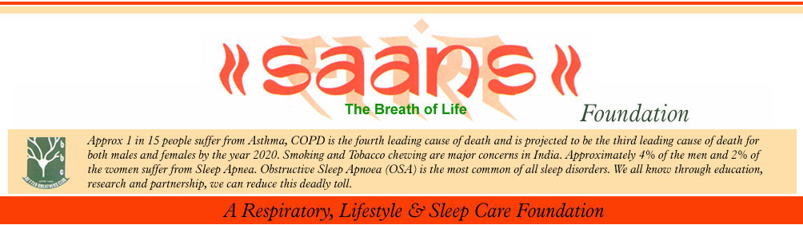
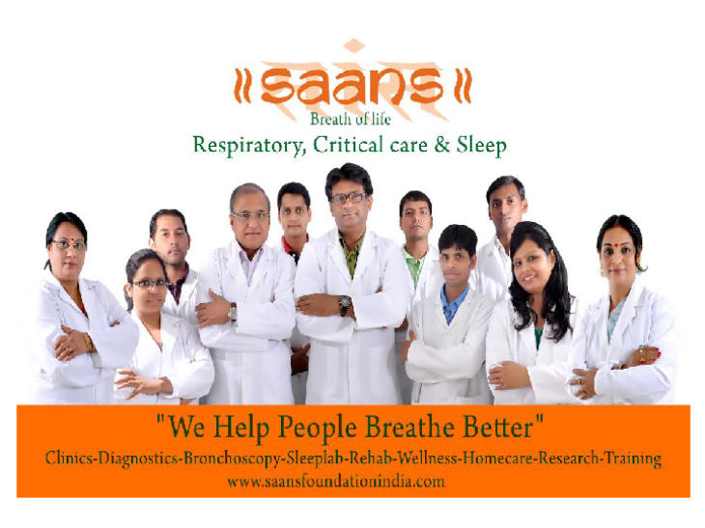
SAANS Foundation is a Super specialty Centre for Respiratory, Allergy, Critical Care, Sleep, Rehabilitation & Training established on 2000 at New Delhi
Recognitions :
Global Initiative on Asthma (GINA),
World Health Organisation (WHO)
American College of Chest Physicians(ACCP)
International Journal of Neuro sciences, US
FICCI
Millennium Alliance,USAIDS
TERI
Cleveland Clinic Foundation, US.

Slide 4
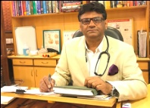
About Dr. P.P Bose
Dr. Bose is a recipient of the Delhi Medical Association Excellence Award in the field of Respiratory, Critical Care and Sleep Medicine and Scroll of Honour for outstanding professional services and incomparable contribution to humanity from University College of Medical Sciences, Delhi University. He is a committed professional but more importantly an empathetic human being committed to providing better quality life to individuals seeking his assistance. Dr.Bose has been honoured as Fellow Indian Sleep Disorders Association (FISDA) for contributing to the growth of sleep disorder medicine in India. Dr Bose has been honoured Fellow Buteko Professional International (FBPI) for his contribution to innovative breathing techniques. He has served in several institutions in the capital namely, Safdarjung Hospital, VIMHANS, Orthonova Hospital, Escorts Hospital Faridabad ,Fortis Hospital Vasant Kunj and Max Super Speciality Hospital, Saket..He is currently Medical Director at lords Institute of Medical Sciences(LIMS) and Senior Consultant at the National Heart Institute
Dr. PP Bose
MD, DTCD,DNB, FISDA,FBPI
Fellow, Buteyko Professional Breathing Techniques
Senior Consultant, Pulmonologist
Pulmonary, Critical Care, Sleep & Rehabilitation
Founder SAANS Foundation
Chairman , SAKSHAM Paramedic Academy
Medical Director, Lords International Hospital
Senior Consultant, National Heart Institute, New Delhi
Bose’s passion and commitment for his profession led him to start the SAANS Foundation, a Respiratory organisation actively involved in community outreach, professional training and research activities in India which had outreach programme for the police officers, the autorickshaw drivers, lawyers, geriatric and school children. The Global Initiative on Asthma (Gina), World Health Organisation (WHO) and American College of Chest Physicians have lauded Dr. Bose’s contribution to respiratory diseases. A strong desire to help people from the lower economic strata and the lack of trained health care workers in the health care industry led to the creation of “sAksham”, a multipurpose capacity building forum. “sAmarth”, Rehabilitation unit works on reversal of chronic diseases using trained physiotherapists and paramedics. “sAhaj” a home care initiative for geriatric and palliative care patients. “sArthak” , an initiative towards Community outreach through CSR and Corporate programs. Please visit Saans Foundation youtube channel for interactive patient education videos.

Slide 5
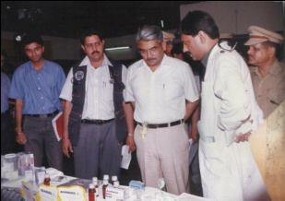
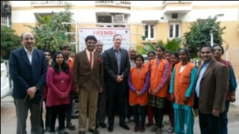
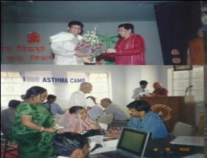
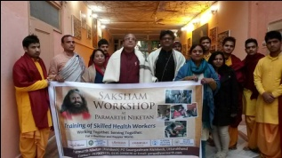
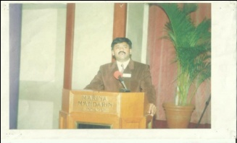
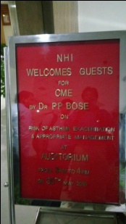
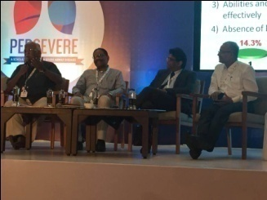
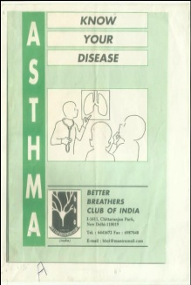
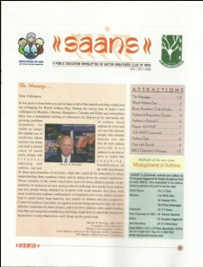
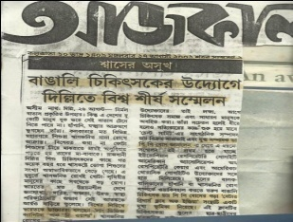
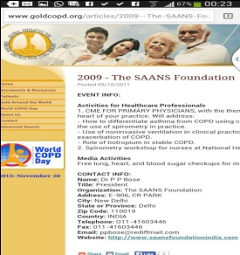
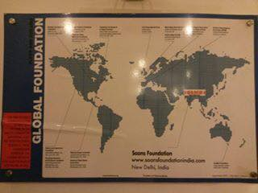
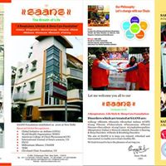
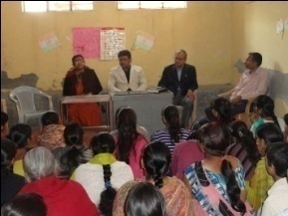
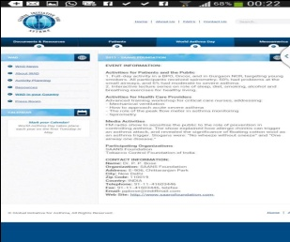
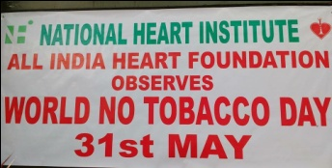
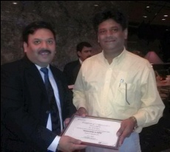
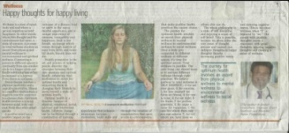
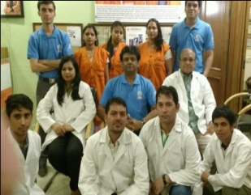
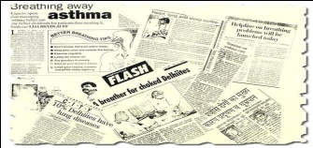
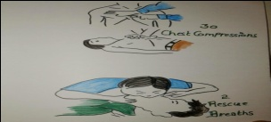
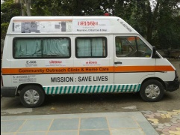
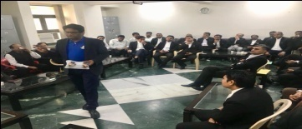
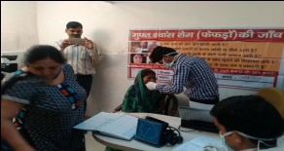
Dr Bose’s Professional Activities
Founder SAANS- SAKSHAM
Medical Director & Chairman, Lords Institute of Respiratory and Allied Sciences
Senior consultant, Pulmonologist, National heart Institute
Visiting consultant, Pulmonologist, Max Super Speciality Hospital, New Delhi
Member , Ethics Committee, Tata Energy & Research Institute, New Delhi
Founder Vice President, Indian Sleep Disorders Association
Fellow, Butekyo Professional International (FBPI)
Fellow , Indian Sleep Disorders Association(FISDA)
On the editorial board of THORAX, Southeast Asia
Chairman , Infection Control Committee, National Heart Institute, New Delhi
Examiner & faculty, MPT, HAMDARD University
On the Editorial board of Sleep Journal
Consultant FICCI
Jury, Millennium Alliance, USAIDS
On the editorial board of a magazine for children, Child
Consultant, Chest Research Foundation, Pune, India
Key opinion leaders, Cipla, Sun , Astra, Abbot pharmaceuticals
Medical Advisor, Enersol, USA
Ex Senior consultant, Escorts Hospital, NCR
Ex Senior Consultant Pulmonology, Fortis, Vasant Kunj, New Delhi
Ex Senior consultant, VIMHANS
EX Medical Superintendent & Medical Director Orthonova Hospital, New Delhi

Slide 6

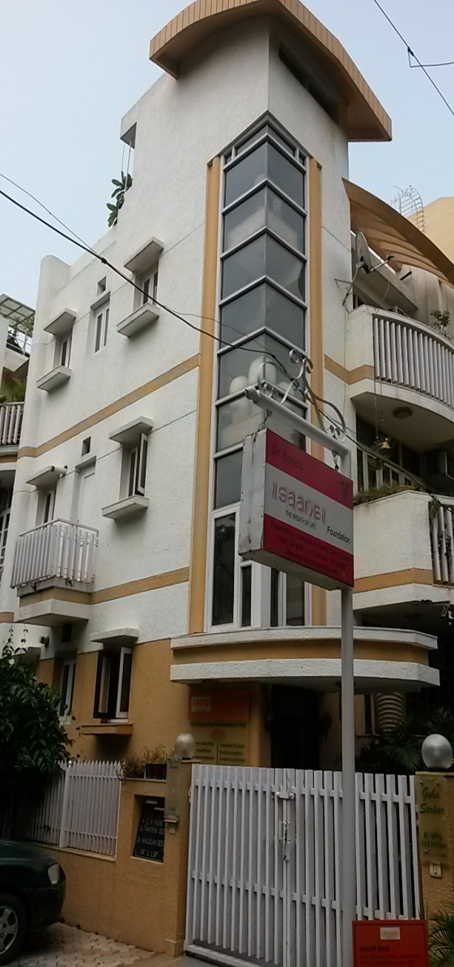
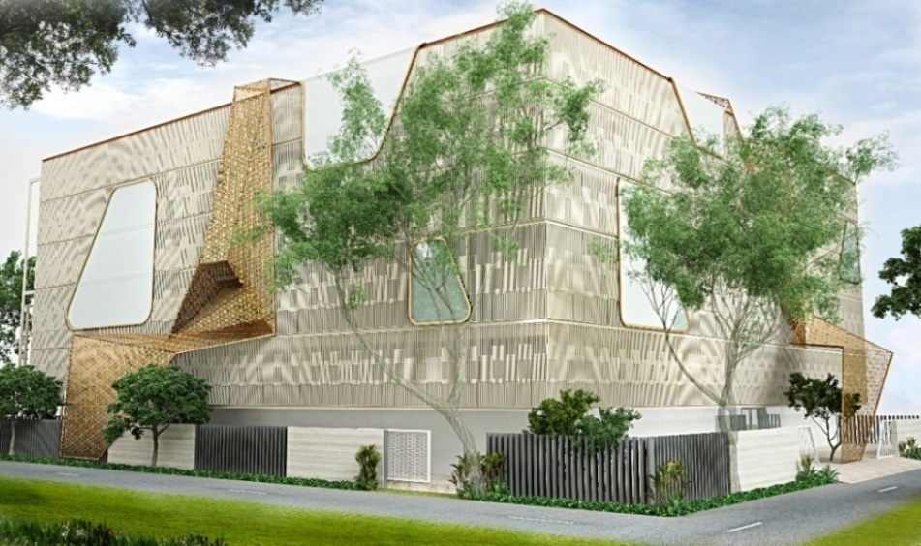
Our Centers In South Delhi
Lords International Hospital
An Upcoming 250 Bedded Superspecialty Hospital of Respiratory and Critical Care
SAANS Foundation
A Superspecialty Center for Respiratory, Critical Care, Allergy, Sleep, Rehabilitation & Training

Slide 7
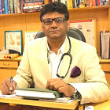
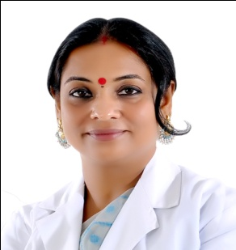
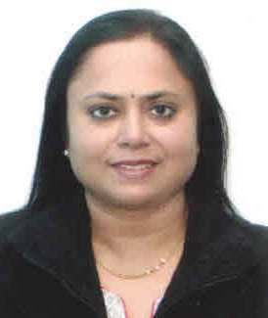
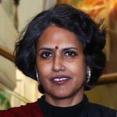
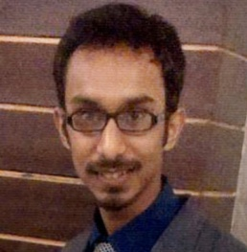
People Behind
Dr. P.P. Bose
Founder , SAANS Foundation
Chairman, SAKSHAM
Dr. Mausmi Bose
Vice- President, SAANS Foundation
Co- Chairman, SAKSHAM
Mr. Ranjan Bose
Chief advisor and Planning, SAANS-SAKSHAM
Ms. Madhulika Chatterjee
Senior Consultant & Project Head, SAANS-SAKSHAM
Ms. Sharmila Abraham
Co- Chair, SAANS-SAKSHAM
Dr. Siddhant Dutta (P.T)
Director Rehabilitation, SAANS Foundation

Slide 8











Our Project Partners

Slide 9

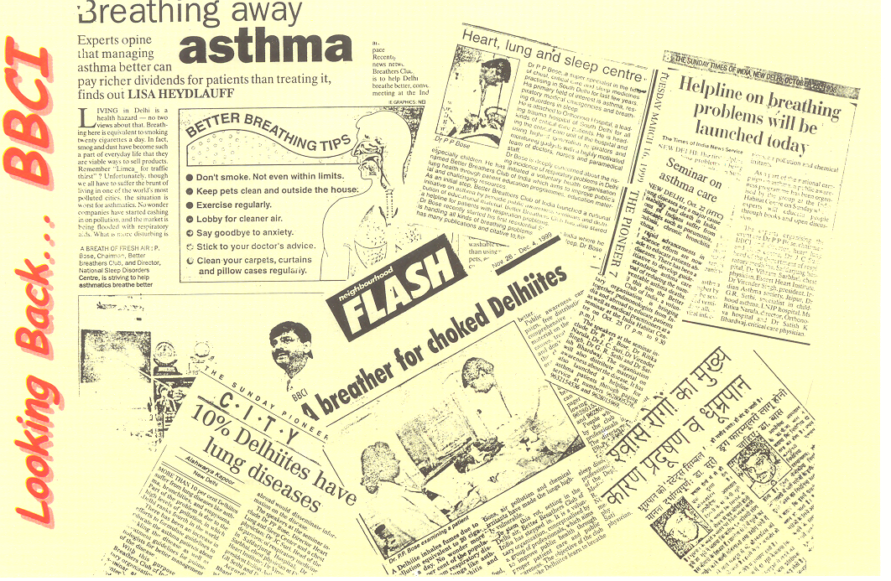

Slide 10
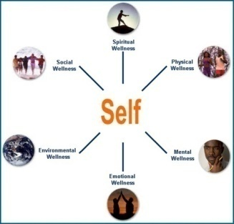
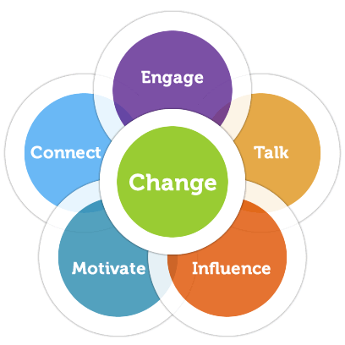

Our vision
Reaching people and touching lives by our values of
“Quality~Reliability~Trust~Innovation~Training~Empathy”
Our Belief
“We can Change with Chain”
Our Philosophy
“Creating Empathy not Sympathy”
Our Approach
“Journey from Illness to wellness”
www.saansfoundationindia.com

Slide 11
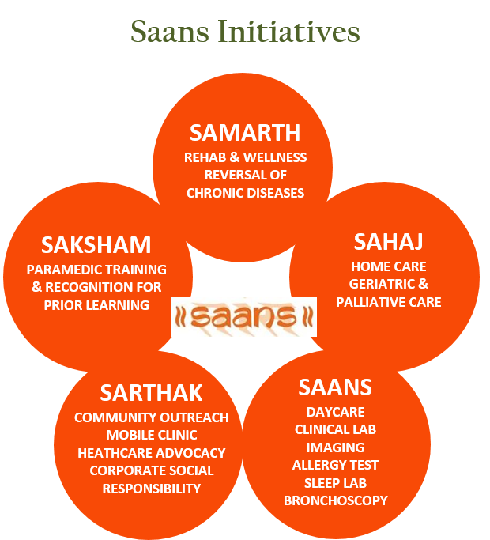
Our Mission: “Saving Lives”
Through Our

Slide 12
Some Facts & Figures of Corporate Health

Slide 13
Sobering truth
India represents the world’s workforce.
Urban professionals are now combating first world problems such as lifestyle illnesses, mental health issues, stress and that elusive work-life balance.
Assocham study released 2017 revealed that 42.5 percent of employees suffer from depression.
WHO says that around 350 million people of all ages suffer from depression and it is the leading cause of suicide among 15-29-year-olds. “Such alarming statistics call for awareness to be raised about depression and anxiety”

Slide 14
Reasons
Fear of job loss, termination, disciplinary actions, and ongoing inquiries
Financial concerns, huge debts
Unable to meet expectations, deadlines
Feelings of failure and unfairness
Job dissatisfaction, unhappy with the job location (homesickness), no clear job profile (stagnation and frustration)
Harassment (sexual and non-sexual)
Excessive burnout, emotional exhaustion, overwork, and sleep deprivation.

Slide 15
Signs that something is wrong
Absenteeism
Physical ailments
Poor work performance
Accident proneness
Tension and conflict with co-workers
Harmful substance abuse
Alcoholism
Suicidal ideation

Slide 19
Research shows 85 % *of the employees in the private sector suffer from lifestyle-related chronic diseases such as :
      High blood pressure
      Diabetes
      Cardiovascular disease
      Obesity
      Infertility
      Arthritis
      Back pain
      Knee problems
      *(Associated Chambers of Commerce and Industry of India ASSOCHAM,2013)

Slide 20

Anxiety... one of the most prevalent Mental Health Disorders
Anxiety is one of the most prevalent mental health disorders. 1 in 14 people in the world is likely to suffer from it. Anxiety is often the precursor to depression and very few people who need treatment actually receive it. Studies reveal that women are twice as likely as men to develop generalised anxiety disorders

Slide 21
SAANS Corporate Initiatives

Slide 22
About SAANS Corporate Wellness
At SAANS Wellness, we actively work on redefining 'wellness' in our journey from “Illness to Wellness” a 360 degree approach from physical, mental,emotional,enviormental, social to spiritual wellness thereby enhancing corporate wellness, engagement and productivity.

Slide 23
Promote Preventative Care
Awareness workshops
Medical check-ups
Flu and other vaccinations
Specialized areas

Slide 24
Campaigns
Compelling campaigns to engage, educate and drive healthy actions – a key element of successful corporate wellness programs

Slide 25
Specific Areas
Tobacco Cessation
Lung check
Sleep disorder
Breathing Retraining
Pilates

Slide 26
Fitness Training
Fitness programs
Nutrition program
Endurance training
Breathing retraining
Pilates
Yoga

Slide 27
Onsite Clinics
Onsite Clinic Services includes:
Multidisciplinary consultations with doctors,
Nutritionists,
Exercise Physiologists,
Wellness Coach
as part of a complete corporate wellness program

Slide 28
Functional Training:
How can it enhance one’s ability to perform daily activities?
Functional training helps you build strength, power, and mobility that translate beyond the gym. It enhances one’s ability to perform activities in daily life.
For example, a squat is a functional exercise because it also works the muscles you use to squat down and grab something you dropped.

Slide 29
Our Community Outreach & Corporate Projects

Slide 30
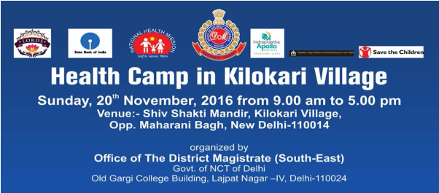
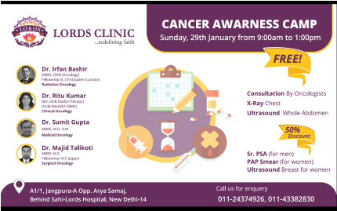
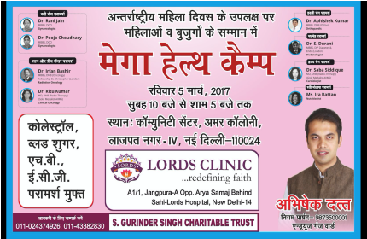
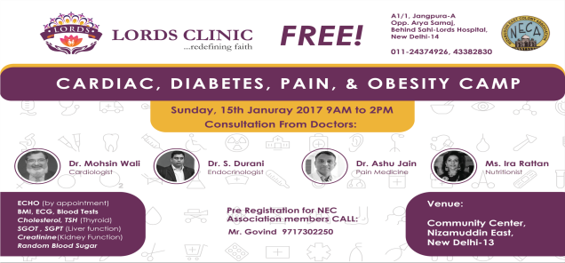
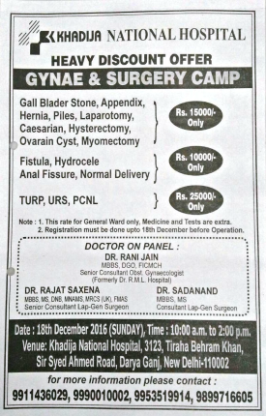
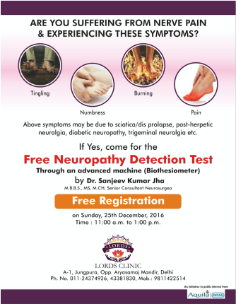
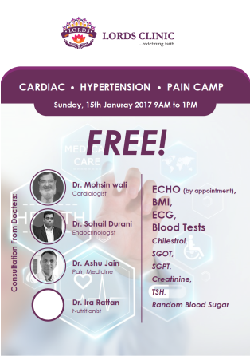
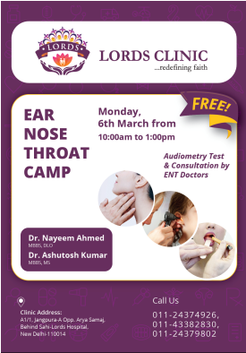

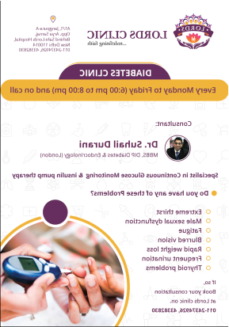
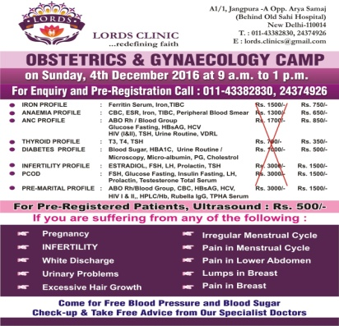
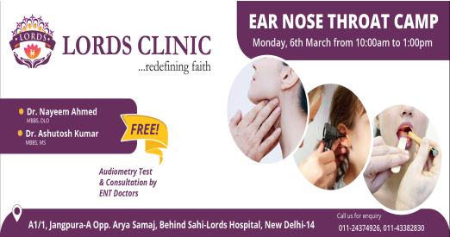
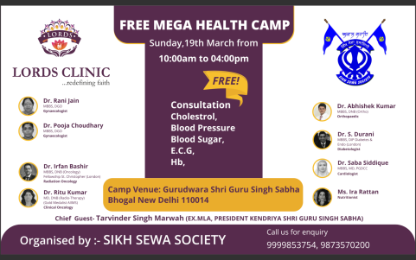









Heath Camps & Advocacy

Slide 31




























SAANS Media Outreach & Wellness Columns

Slide 32













Respiratory Awareness Initiatives

Slide 33
Smoke Less Delhi Initiative

Slide 34


Choose Life Study done on Smokers Shows Poor Mental Health And Hypersensitive Behavior in Smokers

Slide 35

SAANS Awarded among top 10 Global Foundation For Excellence in Sleep and Sleep Related Disorders

Slide 36










Sleep Advocacy & Awareness for High Risk Population

Slide 37





Buteyko Professional International Breathing Techniques

Slide 38




More Breath Per Breath Program
SAANS Power Breath
Breathe deeply with SAANS POWER breathe for more energy
Deep breathing reaches the deepest depths of your lungs, and by practicing SAANS POWER breathe inspiratory muscle training you’ll be training your respiratory muscles to breathe deeply into your diaphragm, taking in as much air as possible, breathing more in per breath. As you’re breathing in more air per breath, you’re receiving more oxygen into your body, giving you more energy. Senior consultant at the National heart Institute, India, and Founder, SAANS Foundation in India, Partha Pratim Bose offers a good example of this,
“By deep breathing exercises you breathe more per breath. If you breathe more per breath you expand your lungs more, you receive more oxygen. You will feel more energetic and also save your breaths. For example, if you breathe 250 ml per breath and your requirement is 5 liters then you need 20 breaths per minute. If you breathe more breath say double i.e. 500ml then you will require only ten breaths. So by breathing deep you breathe less and you feel better and conserve energy.”
Dr. Anthony Alessi, Associate Clinical Professor of Neurology at the University of Connecticut, wrote in an article in The Norwich Bulletin quoted SAANS Power Breath, 2017

Slide 39

Nutrition

Slide 40

Pilates For Corporates

Slide 41








































SAKSHAM
Capacity building in Health Care Sector recognized by HSSC, Govt of India
GDA & EMT

Slide 42












Samarth
Rehabilitation & Wellness

Slide 43

















Our Books, Manuals, Journals, & More Recommended by Many National & International Institutions

Slide 44






















Patients Speak

Slide 45


